Slide 1
Variant Representation and Interpretation
Sequencing Technologies and Bioinformatics Analysis 2024
Cold Spring Harbor Laboratories
Notes:
Note: ran through this in ~40-45 minutes; can be longer next time

Slide 2
You should be familiar with...
NGS File Formats
Fundamentals of sequence alignment
Variant calling

Slide 3
Domain-Specific Applications of Genomic Data Standards
High-throughput computing
Clinical / biomedical reporting
Computer-driven discovery

Slide 4
Domain-Specific Applications of Genomic Data Standards
High-throughput computing
Clinical / biomedical reporting
Computer-driven discovery
These different applications play complementary roles in variant interpretation!

Slide 5
Domain-Specific Applications of Genomic Data Standards
High-throughput computing
How do we represent sequencing instrument data for a sample?
How do we represent all of the data across multiple samples?

Slide 6

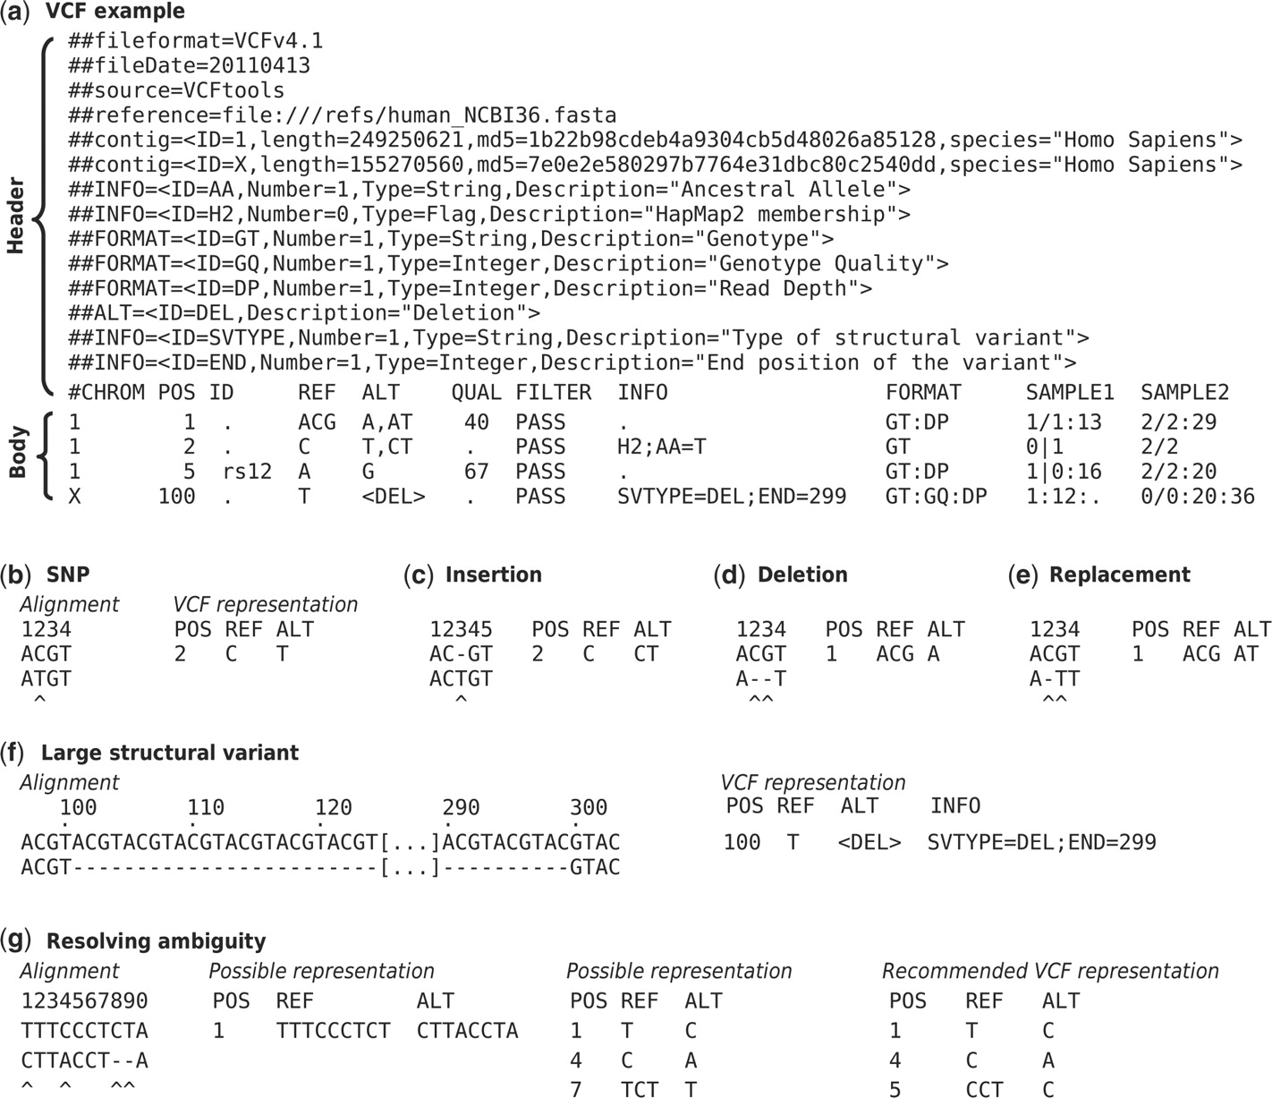

Fig. 1. (a) Example of valid VCF.
Notes:
Fig. 1. (a) Example of valid VCF. The header lines ##fileformat and #CHROM are mandatory, the rest is optional but strongly recommended. Each line of the body describes variants present in the sampled population at one genomic position or region. All alternate alleles are listed in the ALT column and referenced from the genotype fields as 1-based indexes to this list; the reference haplotype is designated as 0. For multiploid data, the separator indicates whether the data are phased (|) or unphased (/). Thus, the two alleles C and G at the positions 2 and 5 in this figure occur on the same chromosome in SAMPLE1. The first data line shows an example of a deletion (present in SAMPLE1) and a replacement of two bases by another base (SAMPLE2); the second line shows a SNP and an insertion; the third a SNP; the fourth a large structural variant described by the annotation in the INFO column, the coordinate is that of the base before the variant. (b–f) Alignments and VCF representations of different sequence variants: SNP, insertion, deletion, replacement, and a large deletion. The REF columns shows the reference bases replaced by the haplotype in the ALT column. The coordinate refers to the first reference base. (g) Users are advised to use simplest representation possible and lowest coordinate in cases where the position is ambiguous.
Unless provided in the caption above, the following copyright applies to the content of this slide: © The Author(s) 2011. Published by Oxford University Press.This is an Open Access article distributed under the terms of the Creative Commons Attribution Non-Commercial License (http://creativecommons.org/licenses/by-nc/2.5), which permits unrestricted non-commercial use, distribution, and reproduction in any medium, provided the original work is properly cited.© The Author(s) 2011. Published by Oxford University Press.

Slide 7
Variant Call Format
Compact representation of many genomic variants over many samples
Useful for large-scale genomic sequencing projects, such as the 1000 Genomes Project
Predominant output format for variant calling in bioinformatics pipelines
Optimized for short / non-complex variants on a genomic reference
Notes:
The header begins the file and provides metadata describing the body of the file. Header lines are denoted as starting with #. Special keywords in the header are denoted with ##. Recommended keywords include fileformat, fileDate and reference.
The header contains keywords that optionally semantically and syntactically describe the fields used in the body of the file, notably INFO, FILTER, and FORMAT (see below).

Slide 8
Variant Call Format - Header
Notes:
Fig. 1. (a) Example of valid VCF. The header lines ##fileformat and #CHROM are mandatory, the rest is optional but strongly recommended. Each line of the body describes variants present in the sampled population at one genomic position or region. All alternate alleles are listed in the ALT column and referenced from the genotype fields as 1-based indexes to this list; the reference haplotype is designated as 0. For multiploid data, the separator indicates whether the data are phased (|) or unphased (/). Thus, the two alleles C and G at the positions 2 and 5 in this figure occur on the same chromosome in SAMPLE1. The first data line shows an example of a deletion (present in SAMPLE1) and a replacement of two bases by another base (SAMPLE2); the second line shows a SNP and an insertion; the third a SNP; the fourth a large structural variant described by the annotation in the INFO column, the coordinate is that of the base before the variant. (b–f) Alignments and VCF representations of different sequence variants: SNP, insertion, deletion, replacement, and a large deletion. The REF columns shows the reference bases replaced by the haplotype in the ALT column. The coordinate refers to the first reference base. (g) Users are advised to use simplest representation possible and lowest coordinate in cases where the position is ambiguous.
Unless provided in the caption above, the following copyright applies to the content of this slide: © The Author(s) 2011. Published by Oxford University Press.This is an Open Access article distributed under the terms of the Creative Commons Attribution Non-Commercial License (http://creativecommons.org/licenses/by-nc/2.5), which permits unrestricted non-commercial use, distribution, and reproduction in any medium, provided the original work is properly cited.© The Author(s) 2011. Published by Oxford University Press.

Slide 9
Variant Call Format - Columns
Notes:
Fig. 1. (a) Example of valid VCF. The header lines ##fileformat and #CHROM are mandatory, the rest is optional but strongly recommended. Each line of the body describes variants present in the sampled population at one genomic position or region. All alternate alleles are listed in the ALT column and referenced from the genotype fields as 1-based indexes to this list; the reference haplotype is designated as 0. For multiploid data, the separator indicates whether the data are phased (|) or unphased (/). Thus, the two alleles C and G at the positions 2 and 5 in this figure occur on the same chromosome in SAMPLE1. The first data line shows an example of a deletion (present in SAMPLE1) and a replacement of two bases by another base (SAMPLE2); the second line shows a SNP and an insertion; the third a SNP; the fourth a large structural variant described by the annotation in the INFO column, the coordinate is that of the base before the variant. (b–f) Alignments and VCF representations of different sequence variants: SNP, insertion, deletion, replacement, and a large deletion. The REF columns shows the reference bases replaced by the haplotype in the ALT column. The coordinate refers to the first reference base. (g) Users are advised to use simplest representation possible and lowest coordinate in cases where the position is ambiguous.
Unless provided in the caption above, the following copyright applies to the content of this slide: © The Author(s) 2011. Published by Oxford University Press.This is an Open Access article distributed under the terms of the Creative Commons Attribution Non-Commercial License (http://creativecommons.org/licenses/by-nc/2.5), which permits unrestricted non-commercial use, distribution, and reproduction in any medium, provided the original work is properly cited.© The Author(s) 2011. Published by Oxford University Press.

Slide 10
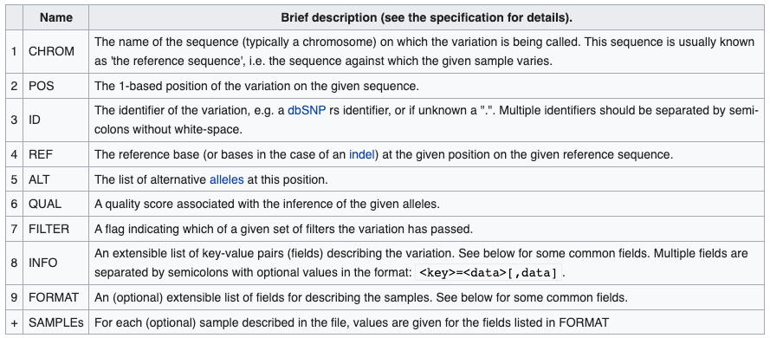
Variant Call Format - Columns
Notes:
The body of VCF follows the header, and is tab separated into 8 mandatory columns and an unlimited number of optional columns that may be used to record other information about the sample(s). When additional columns are used, the first optional column is used to describe the format of the data in the columns that follow.

Slide 11
Variant Call Format - Info

Slide 12
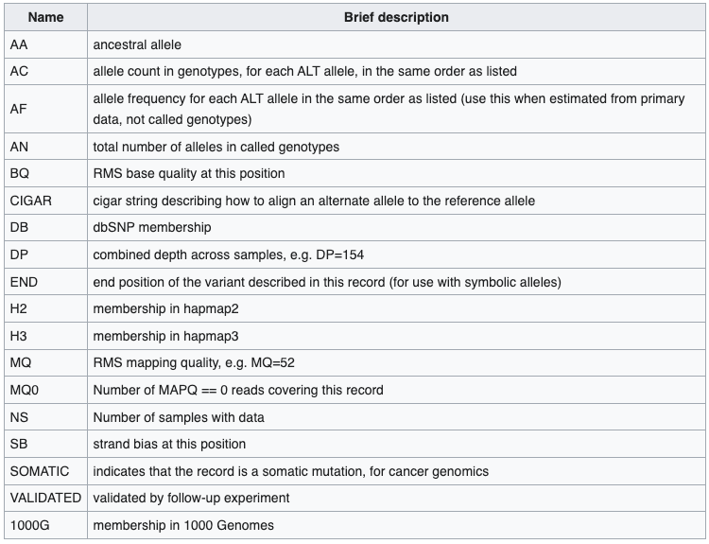
VCF - Info fields

Slide 13
VCF - Info fields

Slide 14
Variant Call Format - Info Field: END
Notes:
Fig. 1. (a) Example of valid VCF. The header lines ##fileformat and #CHROM are mandatory, the rest is optional but strongly recommended. Each line of the body describes variants present in the sampled population at one genomic position or region. All alternate alleles are listed in the ALT column and referenced from the genotype fields as 1-based indexes to this list; the reference haplotype is designated as 0. For multiploid data, the separator indicates whether the data are phased (|) or unphased (/). Thus, the two alleles C and G at the positions 2 and 5 in this figure occur on the same chromosome in SAMPLE1. The first data line shows an example of a deletion (present in SAMPLE1) and a replacement of two bases by another base (SAMPLE2); the second line shows a SNP and an insertion; the third a SNP; the fourth a large structural variant described by the annotation in the INFO column, the coordinate is that of the base before the variant. (b–f) Alignments and VCF representations of different sequence variants: SNP, insertion, deletion, replacement, and a large deletion. The REF columns shows the reference bases replaced by the haplotype in the ALT column. The coordinate refers to the first reference base. (g) Users are advised to use simplest representation possible and lowest coordinate in cases where the position is ambiguous.
Unless provided in the caption above, the following copyright applies to the content of this slide: © The Author(s) 2011. Published by Oxford University Press.This is an Open Access article distributed under the terms of the Creative Commons Attribution Non-Commercial License (http://creativecommons.org/licenses/by-nc/2.5), which permits unrestricted non-commercial use, distribution, and reproduction in any medium, provided the original work is properly cited.© The Author(s) 2011. Published by Oxford University Press.

Slide 15
Variant Call Format - Format and Samples
Notes:
After column 8, remaining columns are optional, for describing multiple samples simultaneously

Slide 16
Variant Call Format - Info Field: END
Notes:
Fig. 1. (a) Example of valid VCF. The header lines ##fileformat and #CHROM are mandatory, the rest is optional but strongly recommended. Each line of the body describes variants present in the sampled population at one genomic position or region. All alternate alleles are listed in the ALT column and referenced from the genotype fields as 1-based indexes to this list; the reference haplotype is designated as 0. For multiploid data, the separator indicates whether the data are phased (|) or unphased (/). Thus, the two alleles C and G at the positions 2 and 5 in this figure occur on the same chromosome in SAMPLE1. The first data line shows an example of a deletion (present in SAMPLE1) and a replacement of two bases by another base (SAMPLE2); the second line shows a SNP and an insertion; the third a SNP; the fourth a large structural variant described by the annotation in the INFO column, the coordinate is that of the base before the variant. (b–f) Alignments and VCF representations of different sequence variants: SNP, insertion, deletion, replacement, and a large deletion. The REF columns shows the reference bases replaced by the haplotype in the ALT column. The coordinate refers to the first reference base. (g) Users are advised to use simplest representation possible and lowest coordinate in cases where the position is ambiguous.
Unless provided in the caption above, the following copyright applies to the content of this slide: © The Author(s) 2011. Published by Oxford University Press.This is an Open Access article distributed under the terms of the Creative Commons Attribution Non-Commercial License (http://creativecommons.org/licenses/by-nc/2.5), which permits unrestricted non-commercial use, distribution, and reproduction in any medium, provided the original work is properly cited.© The Author(s) 2011. Published by Oxford University Press.

Slide 17
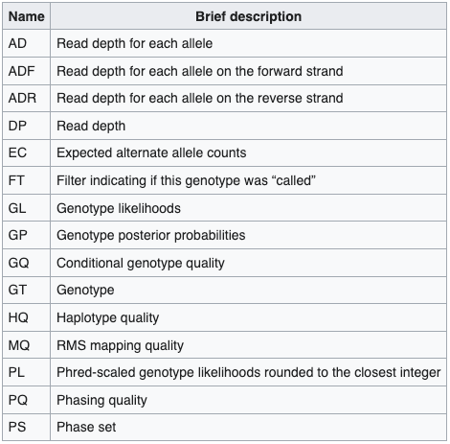
VCF - Format Fields

Slide 18
VCF - Format Fields

Slide 19
Variant Call Format - Format Field: GT
Notes:
Fig. 1. (a) Example of valid VCF. The header lines ##fileformat and #CHROM are mandatory, the rest is optional but strongly recommended. Each line of the body describes variants present in the sampled population at one genomic position or region. All alternate alleles are listed in the ALT column and referenced from the genotype fields as 1-based indexes to this list; the reference haplotype is designated as 0. For multiploid data, the separator indicates whether the data are phased (|) or unphased (/). Thus, the two alleles C and G at the positions 2 and 5 in this figure occur on the same chromosome in SAMPLE1. The first data line shows an example of a deletion (present in SAMPLE1) and a replacement of two bases by another base (SAMPLE2); the second line shows a SNP and an insertion; the third a SNP; the fourth a large structural variant described by the annotation in the INFO column, the coordinate is that of the base before the variant. (b–f) Alignments and VCF representations of different sequence variants: SNP, insertion, deletion, replacement, and a large deletion. The REF columns shows the reference bases replaced by the haplotype in the ALT column. The coordinate refers to the first reference base. (g) Users are advised to use simplest representation possible and lowest coordinate in cases where the position is ambiguous.
Unless provided in the caption above, the following copyright applies to the content of this slide: © The Author(s) 2011. Published by Oxford University Press.This is an Open Access article distributed under the terms of the Creative Commons Attribution Non-Commercial License (http://creativecommons.org/licenses/by-nc/2.5), which permits unrestricted non-commercial use, distribution, and reproduction in any medium, provided the original work is properly cited.© The Author(s) 2011. Published by Oxford University Press.

Slide 20
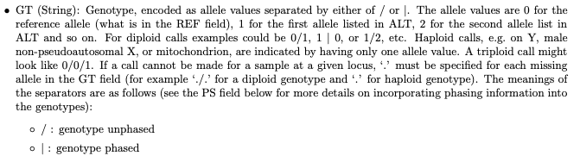
VCF - Format Fields

Slide 21
Variant Call Format - Format Field: GT
Ref = C
Alt1 = T
Alt2 = CT
Sample 1: C | T
Sample 2: CT / CT
Notes:
Fig. 1. (a) Example of valid VCF. The header lines ##fileformat and #CHROM are mandatory, the rest is optional but strongly recommended. Each line of the body describes variants present in the sampled population at one genomic position or region. All alternate alleles are listed in the ALT column and referenced from the genotype fields as 1-based indexes to this list; the reference haplotype is designated as 0. For multiploid data, the separator indicates whether the data are phased (|) or unphased (/). Thus, the two alleles C and G at the positions 2 and 5 in this figure occur on the same chromosome in SAMPLE1. The first data line shows an example of a deletion (present in SAMPLE1) and a replacement of two bases by another base (SAMPLE2); the second line shows a SNP and an insertion; the third a SNP; the fourth a large structural variant described by the annotation in the INFO column, the coordinate is that of the base before the variant. (b–f) Alignments and VCF representations of different sequence variants: SNP, insertion, deletion, replacement, and a large deletion. The REF columns shows the reference bases replaced by the haplotype in the ALT column. The coordinate refers to the first reference base. (g) Users are advised to use simplest representation possible and lowest coordinate in cases where the position is ambiguous.
Unless provided in the caption above, the following copyright applies to the content of this slide: © The Author(s) 2011. Published by Oxford University Press.This is an Open Access article distributed under the terms of the Creative Commons Attribution Non-Commercial License (http://creativecommons.org/licenses/by-nc/2.5), which permits unrestricted non-commercial use, distribution, and reproduction in any medium, provided the original work is properly cited.© The Author(s) 2011. Published by Oxford University Press.

Slide 22
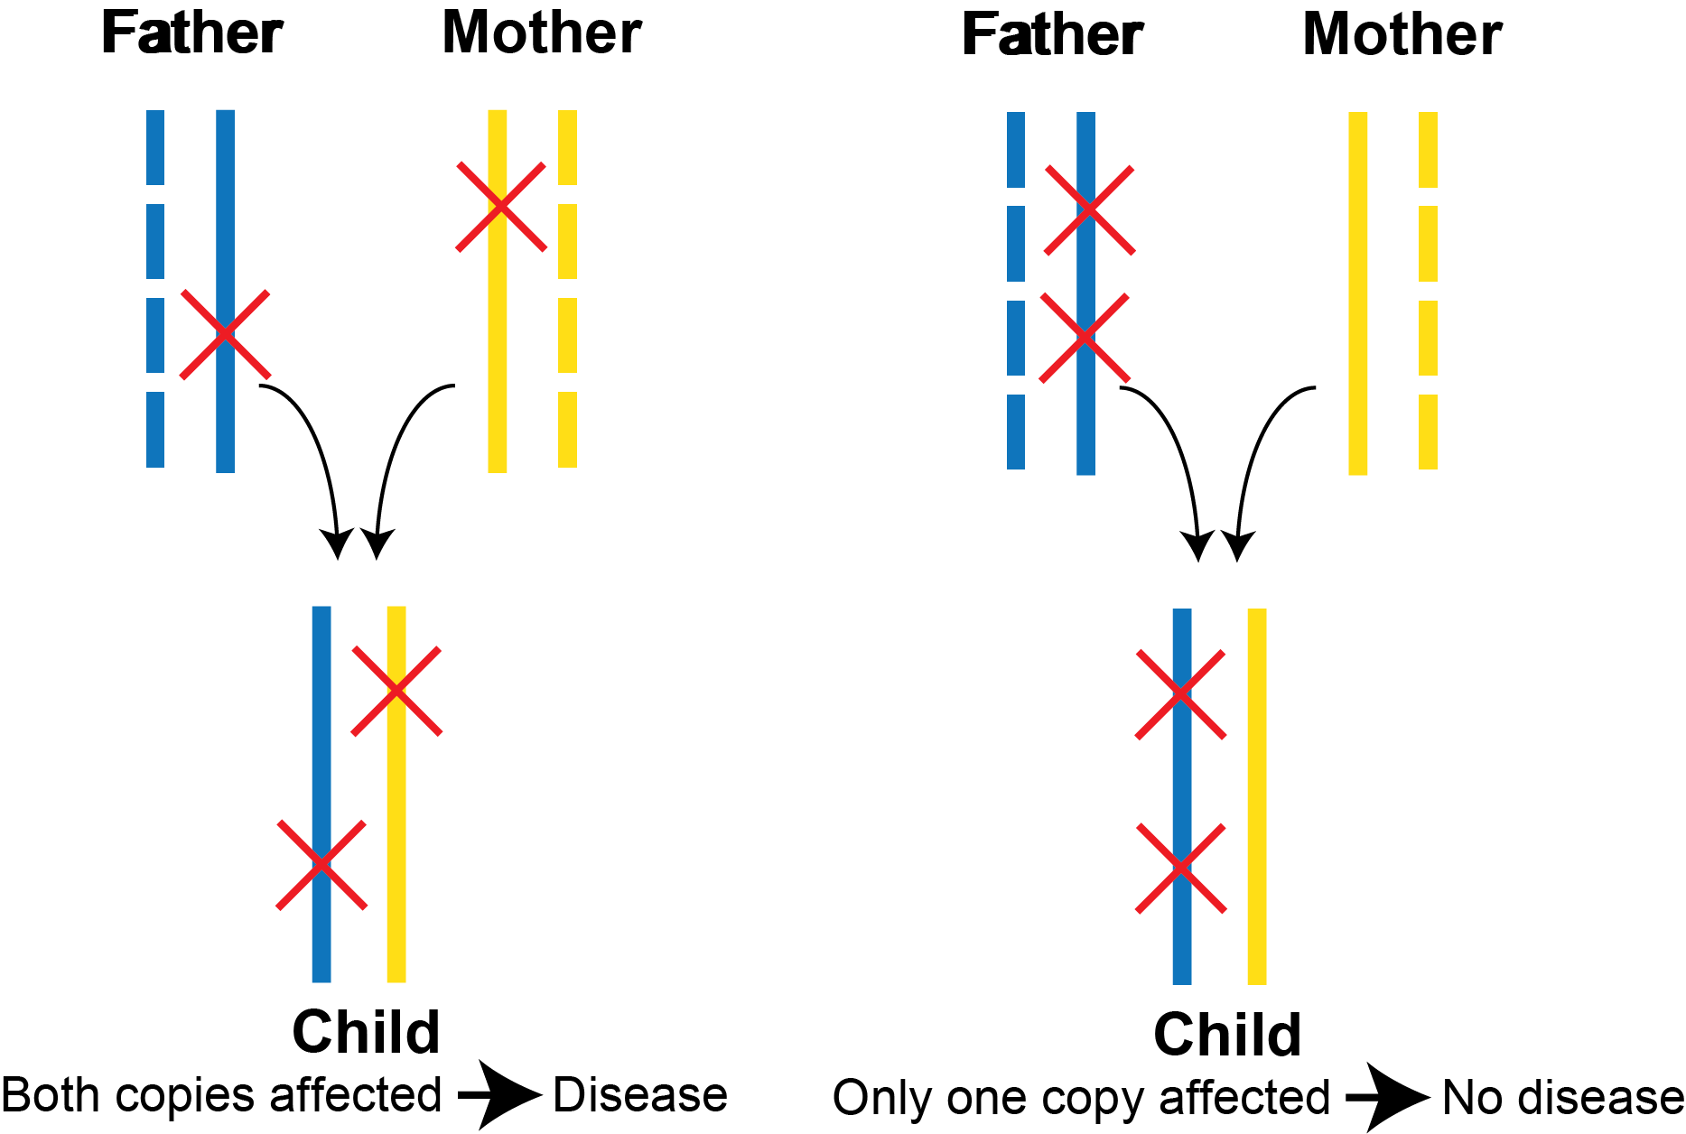
Why is phasing important for variant interpretation?
https://gnomad.broadinstitute.org/news/2021-07-variant-co-occurrence-phasing-information-in-gnomad/

Slide 23
Variant Call Format - Format Field: GT
Sample 1:
2 C phased with 5 G
2 T phased with 5 A
Notes:
Fig. 1. (a) Example of valid VCF. The header lines ##fileformat and #CHROM are mandatory, the rest is optional but strongly recommended. Each line of the body describes variants present in the sampled population at one genomic position or region. All alternate alleles are listed in the ALT column and referenced from the genotype fields as 1-based indexes to this list; the reference haplotype is designated as 0. For multiploid data, the separator indicates whether the data are phased (|) or unphased (/). Thus, the two alleles C and G at the positions 2 and 5 in this figure occur on the same chromosome in SAMPLE1. The first data line shows an example of a deletion (present in SAMPLE1) and a replacement of two bases by another base (SAMPLE2); the second line shows a SNP and an insertion; the third a SNP; the fourth a large structural variant described by the annotation in the INFO column, the coordinate is that of the base before the variant. (b–f) Alignments and VCF representations of different sequence variants: SNP, insertion, deletion, replacement, and a large deletion. The REF columns shows the reference bases replaced by the haplotype in the ALT column. The coordinate refers to the first reference base. (g) Users are advised to use simplest representation possible and lowest coordinate in cases where the position is ambiguous.
Unless provided in the caption above, the following copyright applies to the content of this slide: © The Author(s) 2011. Published by Oxford University Press.This is an Open Access article distributed under the terms of the Creative Commons Attribution Non-Commercial License (http://creativecommons.org/licenses/by-nc/2.5), which permits unrestricted non-commercial use, distribution, and reproduction in any medium, provided the original work is properly cited.© The Author(s) 2011. Published by Oxford University Press.

Slide 24
Domain-Specific Applications of Genomic Data Standards
High-throughput computing
How do we represent sequencing instrument data for a sample?
How do we represent all of the data across multiple samples?
“Foundational standards”
Focus on file formats
Most widespread adoption
Computational emphasis

Slide 25
Domain-Specific Applications of Genomic Data Standards
Clinical / biomedical reporting
How do we compactly describe genomic variation in a way that humans readily understand it?
How do we encode sufficient information to do this accurately?

Slide 26
Variant Nomenclature

Slide 27
Variant Nomenclature
…in the news!

Slide 28

Genomic Data Cracks Cold Case
Daily Mail, September 6, 2014

Slide 29
six weeks later…
Daily Mail, September 9, 2014

Slide 30

Genomic Data Cracks Cold Case… or does it?
The Independent, October 20, 2014

Slide 31
Genomic Data Cracks Cold Case… or does it?
What happened?
The Independent, October 20, 2014

Slide 32
Methodology
DNA sample including killer’s blood includes mitochondrial variation
An insertion in the sample not found in large mitochondrial variation database; a private familial variant!
Descendant of suspect Kosminski’s sister also has familial variation
Conclusion: must be Kosminski!

Slide 33
Methodology
DNA sample including killer’s blood includes mitochondrial variation
An insertion in the sample not found in large mitochondrial variation database; a private familial variant!
Descendant of suspect Kosminski’s sister also has familial variation
Conclusion: must be Kosminski!
There are several shortfalls in the conclusions drawn here.

Slide 34
Methodology
DNA sample including killer’s blood includes mitochondrial variation
An insertion in the sample not found in large mitochondrial variation database; a private familial variant!
Descendant of suspect Kosminski’s sister also has familial variation
Conclusion: must be Kosminski!
There are several shortfalls in the conclusions drawn here.
But the key piece of evidence was misidentified!

Slide 35
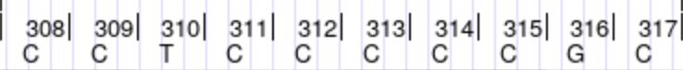
An error of nomenclature!
That private, familial variation: 314.1C
Reported frequency of 314.1C in forensics database: absent
Inserted cytosine
UCSC Genome Browser

Slide 36
An error of nomenclature!
That private, familial variation: 314.1C
Reported frequency of 314.1C in forensics database: absent
Inserted cytosine… somewhere
UCSC Genome Browser

Slide 37
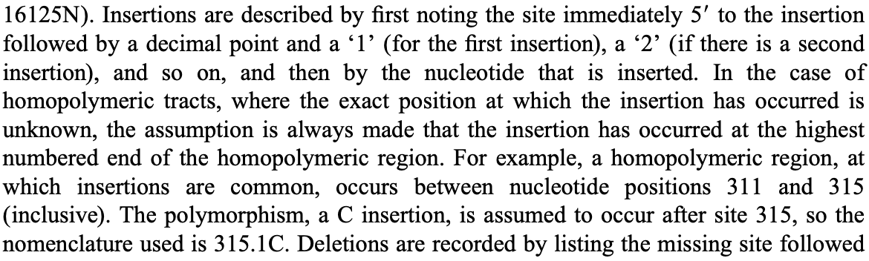
ISFG Mitochondrial Variant Nomenclature (ca. 2000)
DNA Commission of the International Society for Forensic Genetics: guidelines for mitochondrial DNA typing. Forensic Science International. (2000)

Slide 38
ISFG Mitochondrial Variant Nomenclature (ca. 2000)
DNA Commission of the International Society for Forensic Genetics: guidelines for mitochondrial DNA typing. Forensic Science International. (2000)

Slide 39
ISFG Mitochondrial Variant Nomenclature (ca. 2000)
DNA Commission of the International Society for Forensic Genetics: guidelines for mitochondrial DNA typing. Forensic Science International. (2000)

Slide 40
The (Nomenclature) Culprit
That private, familial variation: 315.1C
Reported frequency of 314.1C in forensics database: absent Reported frequency of 315.1C: >99% among European Descent
Inserted cytosine
UCSC Genome Browser

Slide 41
The (Nomenclature) Culprit
That private, familial variation: 315.1C
Reported frequency of 314.1C in forensics database: absent Reported frequency of 315.1C: >99% among European Descent
This type of error is an example consequence of the Variant Overprecision problem (we will get back to this)
Inserted cytosine
UCSC Genome Browser

Slide 42

hgvs.org landing page

Slide 43
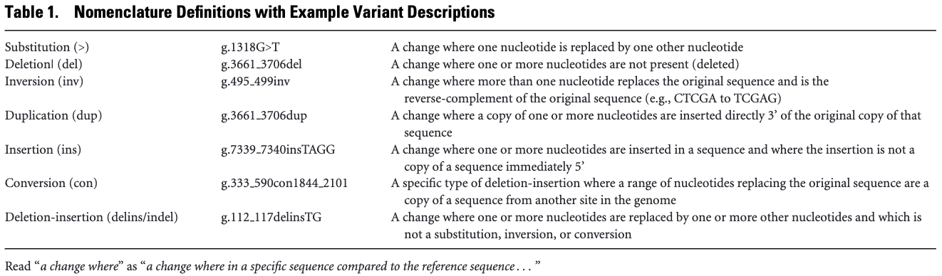
HGVS Variant Nomenclature

Slide 44
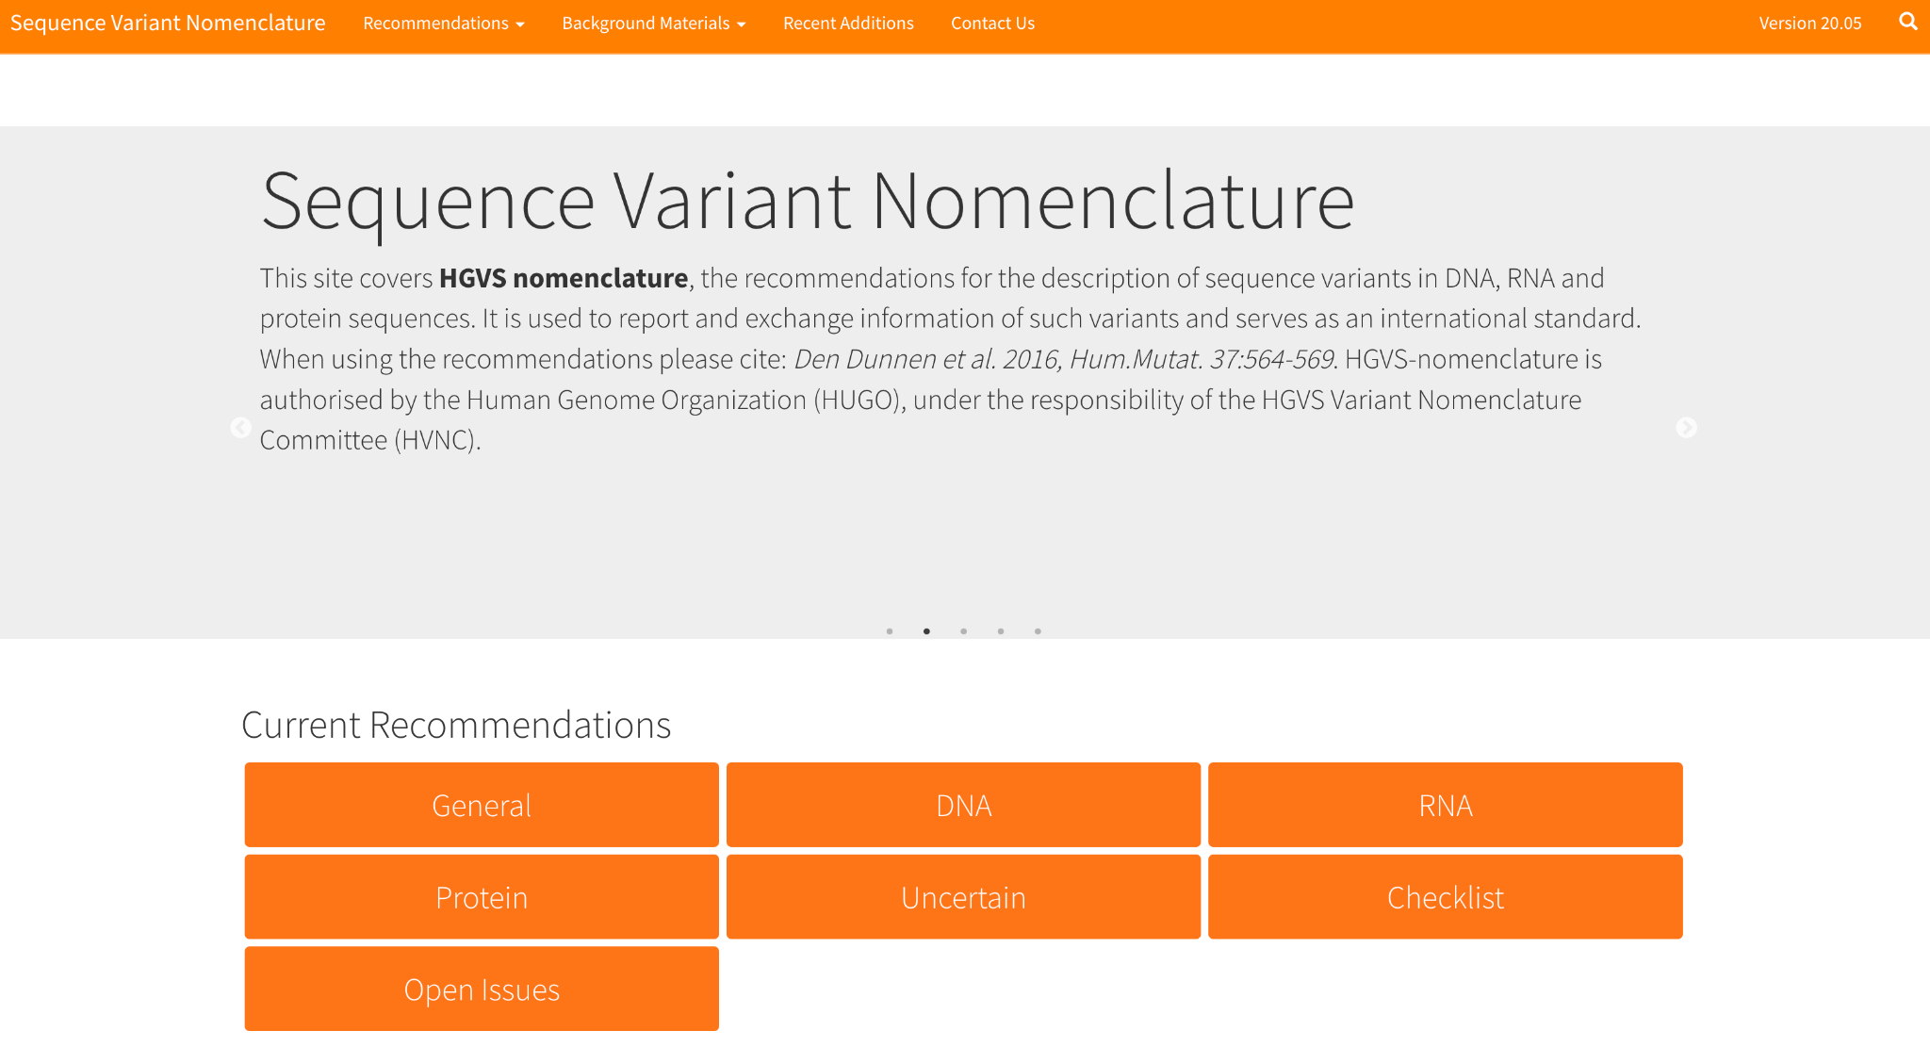
https://varnomen.hgvs.org/

Slide 45
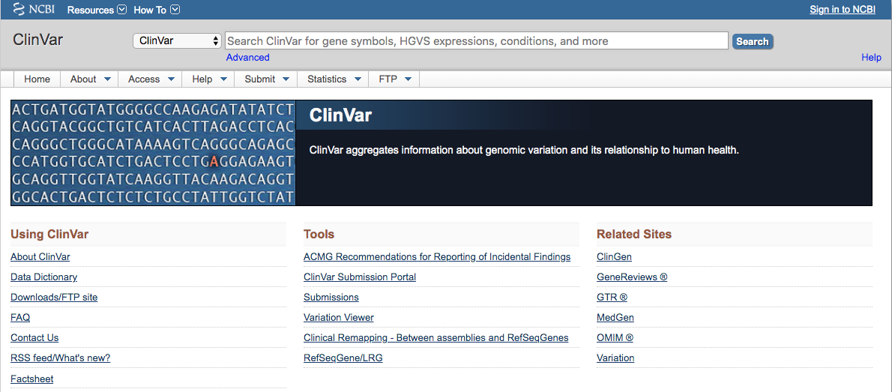
ClinVar
https://www.ncbi.nlm.nih.gov/clinvar/

Slide 46
ClinVar
https://www.ncbi.nlm.nih.gov/clinvar/

Slide 47
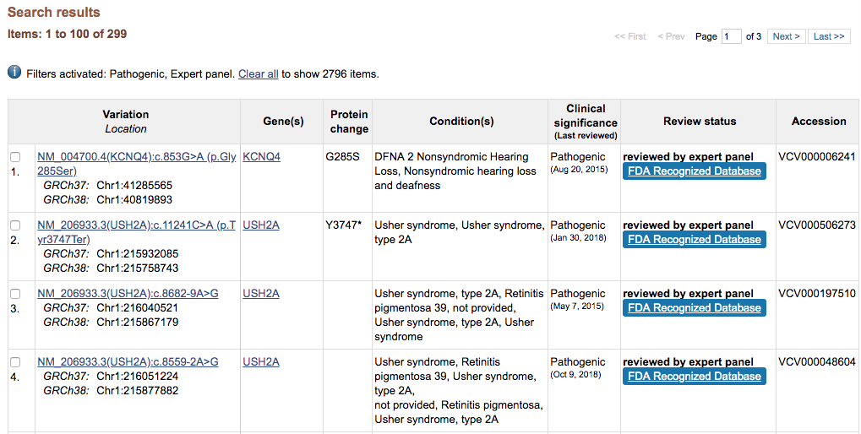
FDA-Recognized ClinGen Classifications

Slide 48
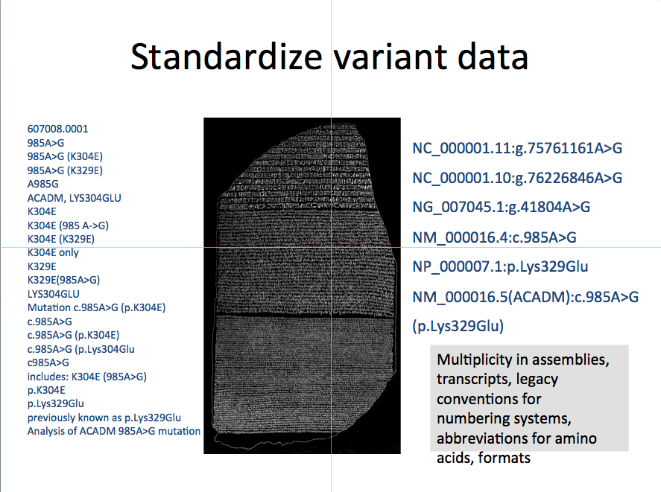
The following is a list of all names submitted to ClinVar for a single variant:
Source: Maglott, D. “The Variant Rosetta Stone [Powerpoint slides]” NCBI, 08 May 2015.

Slide 49
Variant De-duplication Problem
Singular Concept
Multiple human names
NP_004406.2:p.Ser2843_Arg2846del
protein
variation
LRG_423p1:p.Ser2843_Arg2846del
P15924:p.Ser2843_Arg2846del
ENSP00000369129.3:p.Ser2843_Arg2846del
translation
NM_004415.2:c.8472_8483del
transcript
variation
NM_004415.2:c.8472_8483delGTCCCGCTCCGG
ENST00000379802.3:c.8472_8483delGTCCCGCTCCGG
LRG_423t1:c.8472_8483del
CCDS4501.1:c.8472_8483del
projection
NC_000006.11:g.7585967_7585978del
genomic
variation
NC_000006.11:g.7585967_7585978delGTCCCGCTCCGG
NC_000006.12:g.7585734_7585745del
NC_000006.12:g.7585734_7585745delGTCCCGCTCCGG

Slide 50
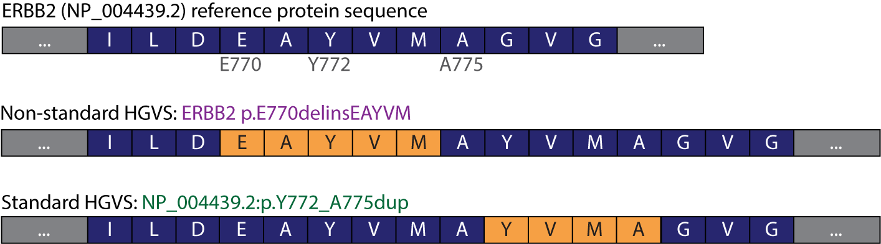
Single concept, multiple non-overlapping representations
Wagner AH, et al. Nat Genet. 2020

Slide 51
Single concept, multiple non-overlapping representations
This is another instance of the Variant Overprecision problem, a key challenge for interoperability between standards.
Wagner AH, et al. Nat Genet. 2020

Slide 52
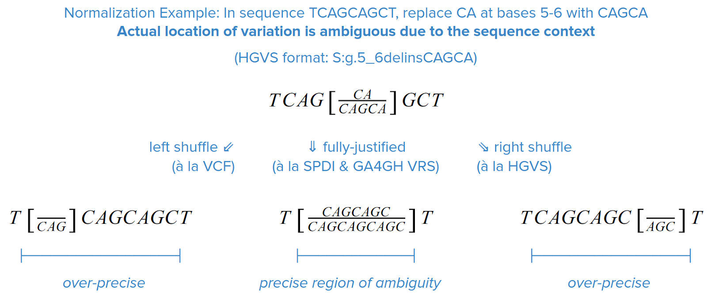

Fully-Justified Normalization Captures Region of Shuffling Ambiguity
Holmes, J.B., Moyer, E., Phan, L., Maglott, D. & Kattman, B. L.
SPDI: Data Model for Variants and Applications at NCBI.
bioRxiv 537449 (2019). doi:10.1101/537449
Slide prepared by Reece Hart

Slide 53
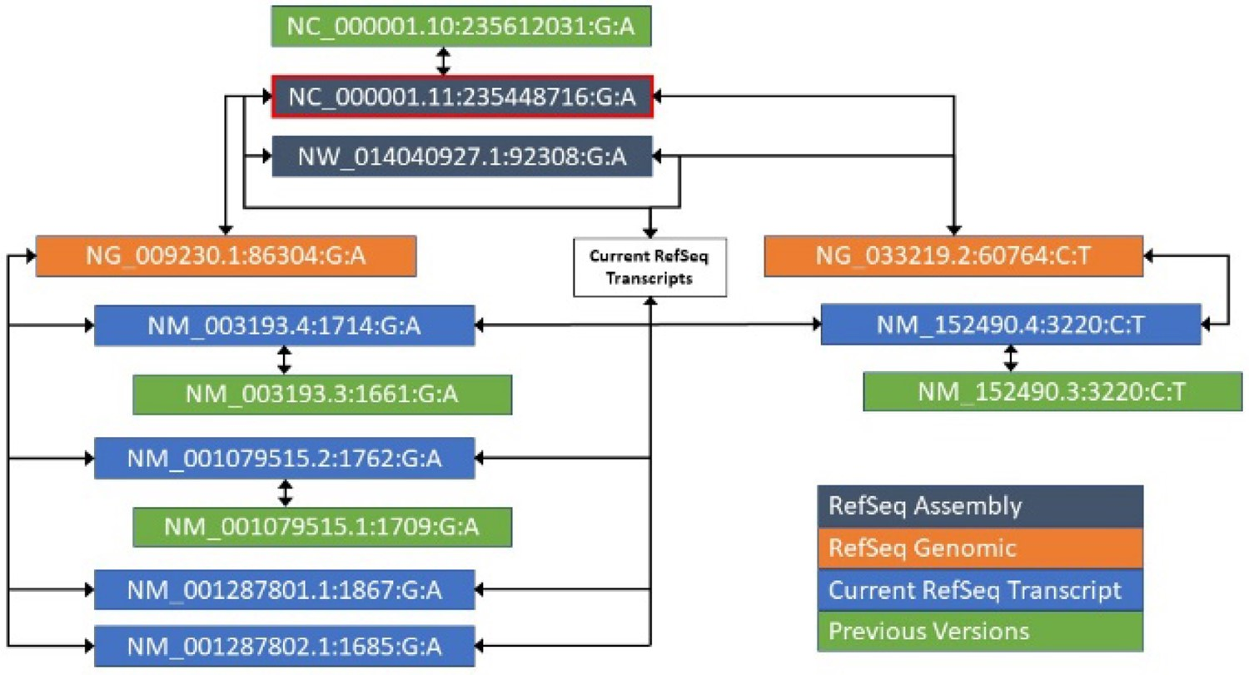
The NCBI Sequence Position Deletion Insertion (SPDI) format
Fig. 1. For rs756655831, a representation of the alignments between various sequences, and the resulting SPDIs.
Notes:
Fig. 1. For rs756655831, a representation of the alignments between various sequences, and the resulting SPDIs. Notably, this RefSNP maps to two RefSeqGenes (TBCE NG_009230.1 and B3GALNT2, NG_033219.2). Each has its own set of transcripts, of which all current ones align to the GRCh38 chromosomal sequence NC_000001.11. All previous versions are aligned only to the current version of the sequence. NW_014040927.1 is a novel patch to chromosome 1 and aligns to only one RefSeqGene, but all transcripts. The location with the red outline is the canonical representation of this set of variants, which allows submissions on any of the sequences to be grouped together
Unless provided in the caption above, the following copyright applies to the content of this slide: Published by Oxford University Press 2019. This work is written by US Government employees and is in the public domain in the US.This article is published and distributed under the terms of the Oxford University Press, Standard Journals Publication Model (https://academic.oup.com/journals/pages/open_access/funder_policies/chorus/standard_publication_model)Published by Oxford University Press 2019. This work is written by US Government employees and is in the public domain in the US.

Slide 54
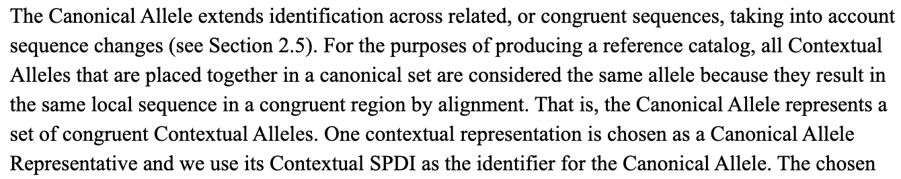
The SPDI Canonical Allele
Holmes JB, et al. Bioinformatics 2019

Slide 55
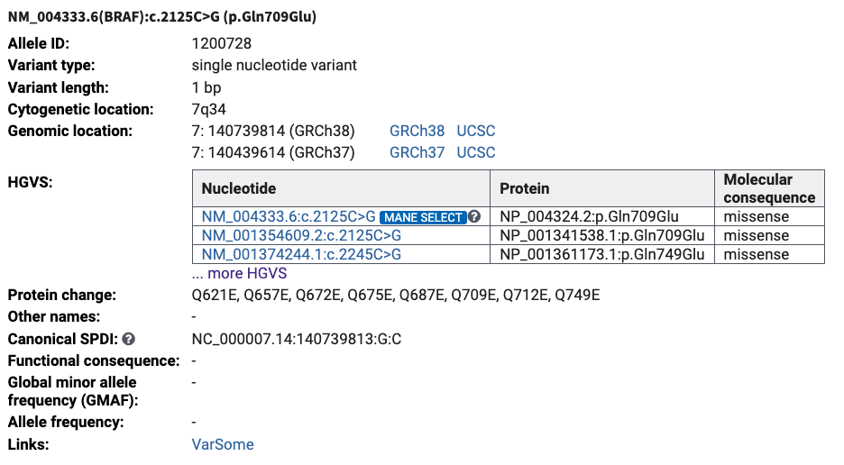
HGVS and the SPDI Canonical Allele in ClinVar

Slide 56
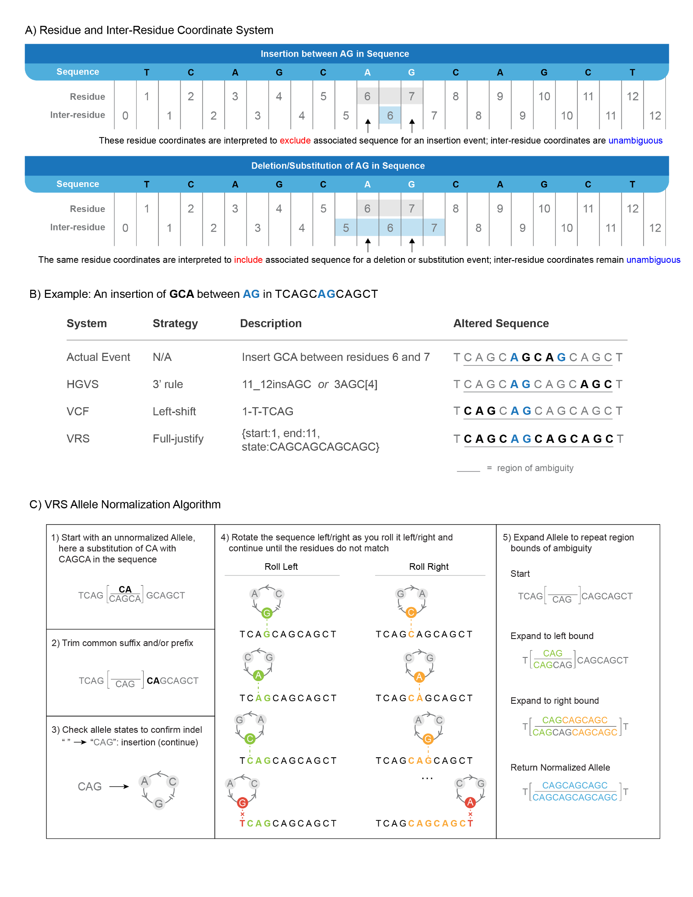
Coordinate Systems: Residue Coordinates
What is the meaning of coordinates Sequence:6-7?
Wagner AH, et al. Cell Genomics. 2021

Slide 57
Coordinate Systems: Inter-residue Coordinates
How can coordinate concepts be described unambiguously? (SPDI, VRS)
Sequence:6-6
Sequence:5-7
Wagner AH, et al. Cell Genomics. 2021

Slide 58
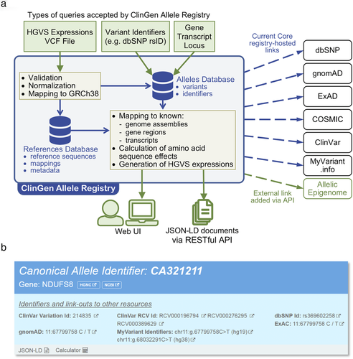
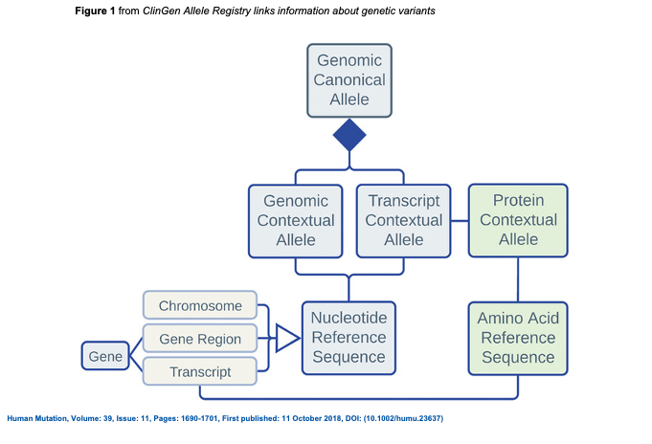
ClinGen Allele Registry
Figures from Pawliczek P, et al. Hum. Mut. 2018
Notes:
Conceptual model of Allele Registry entities based on the Allele Model developed by ClinGen Data Model Working Group
IF THIS IMAGE HAS BEEN PROVIDED BY OR IS OWNED BY A THIRD PARTY, AS INDICATED IN THE CAPTION LINE, THEN FURTHER PERMISSION MAY BE NEEDED BEFORE ANY FURTHER USE. PLEASE CONTACT WILEY'S PERMISSIONS DEPARTMENT ON PERMISSIONS@WILEY.COM OR USE THE RIGHTSLINK SERVICE BY CLICKING ON THE 'REQUEST PERMISSIONS' LINK ACCOMPANYING THIS ARTICLE. WILEY OR AUTHOR OWNED IMAGES MAY BE USED FOR NON-COMMERCIAL PURPOSES, SUBJECT TO PROPER CITATION OF THE ARTICLE, AUTHOR, AND PUBLISHER.

Slide 59
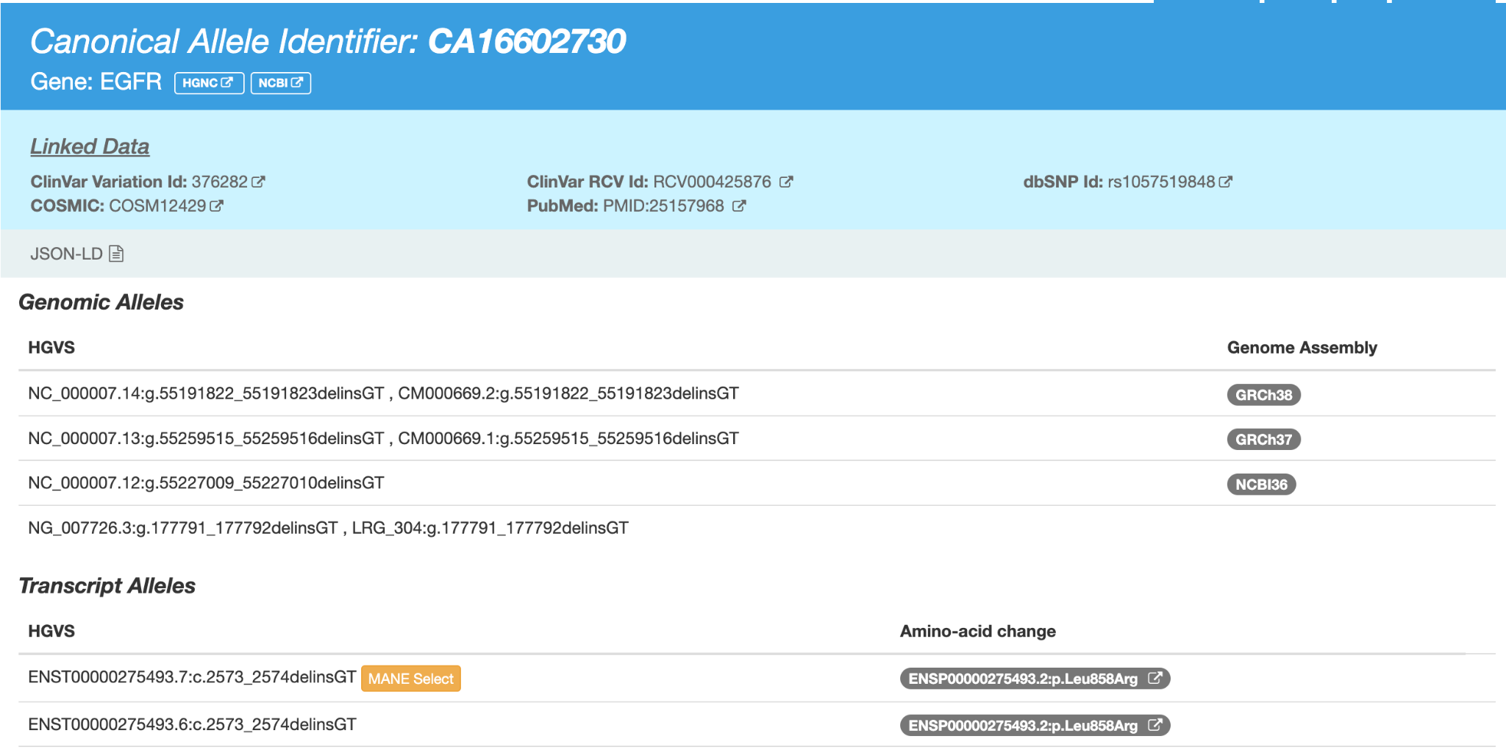

Slide 60
Domain-Specific Applications of Genomic Data Standards
Clinical / biomedical reporting
How do we compactly describe genomic variation in a way that humans readily understand it?
How do we encode sufficient information to do this accurately?
“Nomenclature standards”
Focus on text representation
Many community-specific standards
Readability emphasis

Slide 61
Domain-Specific Applications of Genomic Data Standards
Computer-driven discovery
How do we unambiguously and computationally define genomic data concepts for AI-readiness?
How do we unify diverse variation concepts and embed them in complex computable documents?

Slide 62
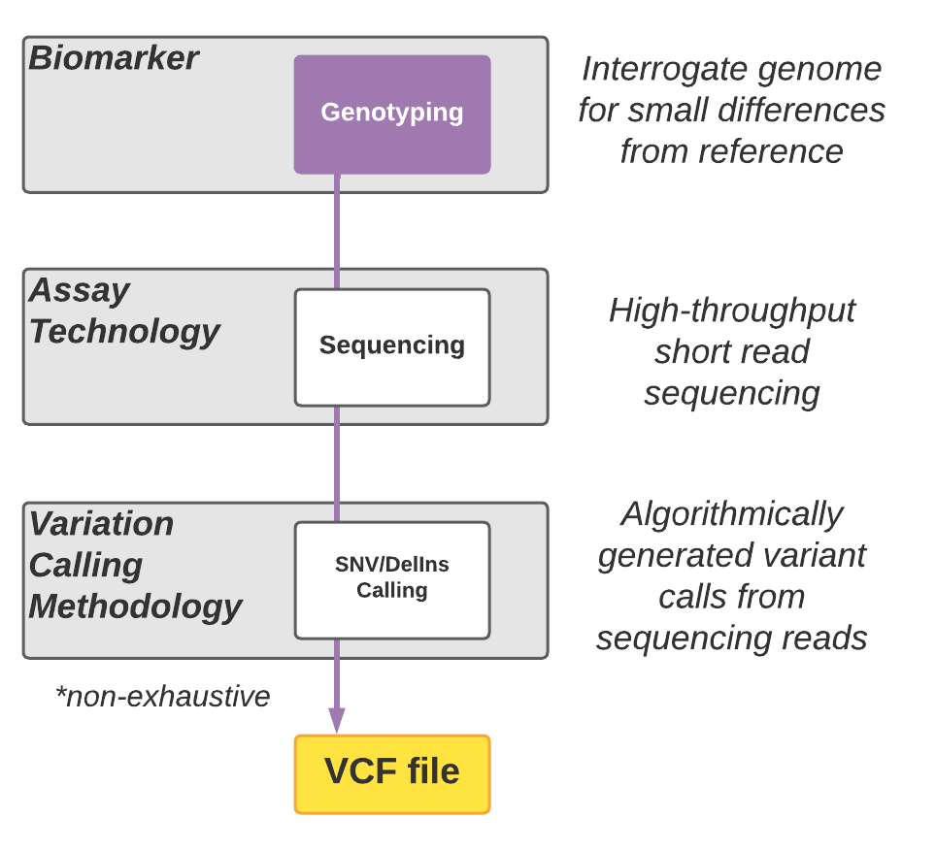
Notes:
AW

Slide 63
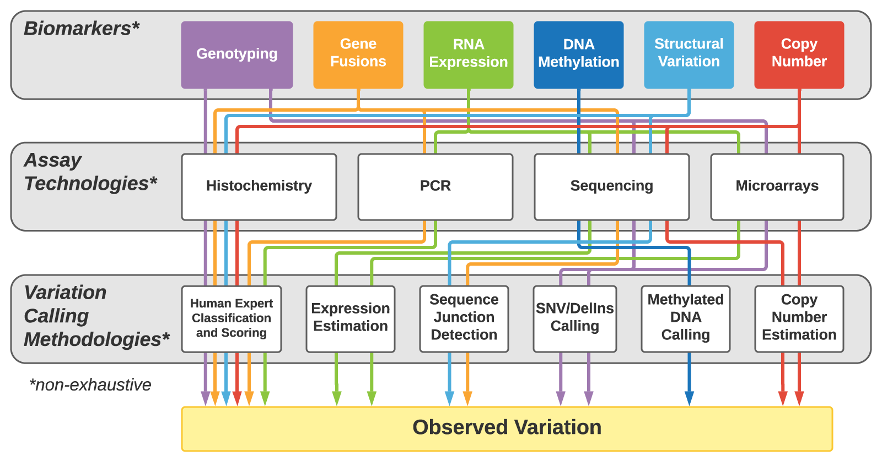
Notes:
AW
Next, a variety of computational and/or human assessments are undertaken to characterize the profiled variation from the assay results.

Slide 64





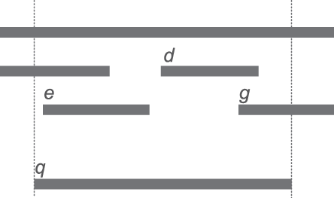
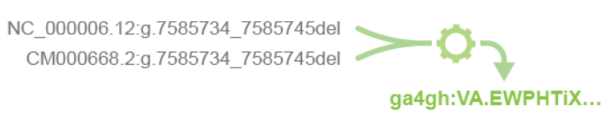
The Variation Representation Specification
VRS is…
Reference
Implementation
…INTEROPERABLE ACROSS FORMATS
Terminology & Information Model
JSON Schema Protocol
GA4GH
Conventions
…SELF-DESCRIPTIVE
ACTG
Other
Exchange
Formats
Alternate
Conventions
…GLOBALLY CONSISTENT AND DECENTRALIZED

Slide 65
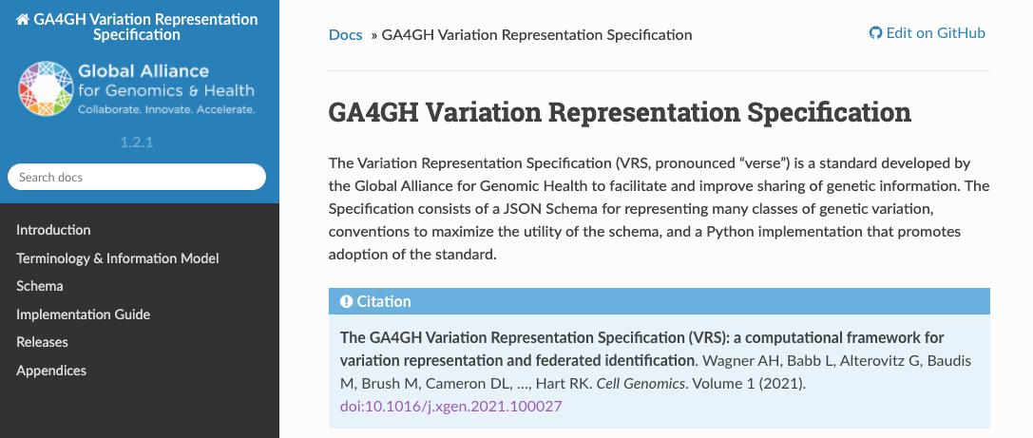
https://vrs.ga4gh.org
Notes:
LB
VRS aims to improve the computational exchange of simple to highly complex forms of variation. The GA4GH Genomic Knowledge Standards Workstream assembled driver projects and individuals to establish VRS and begin extending and maturing it with tooling and system implementations so as to broaden its adoption and realize its aims.
VRS picks up where the variant calling leaves off. It does so based on minimalistic data structures which are designed to significantly increase the interoperability and linkability of datasets that contain variation from heterogeneous sources.
You can find the specification online at vrs.ga4gh.org.

Slide 66
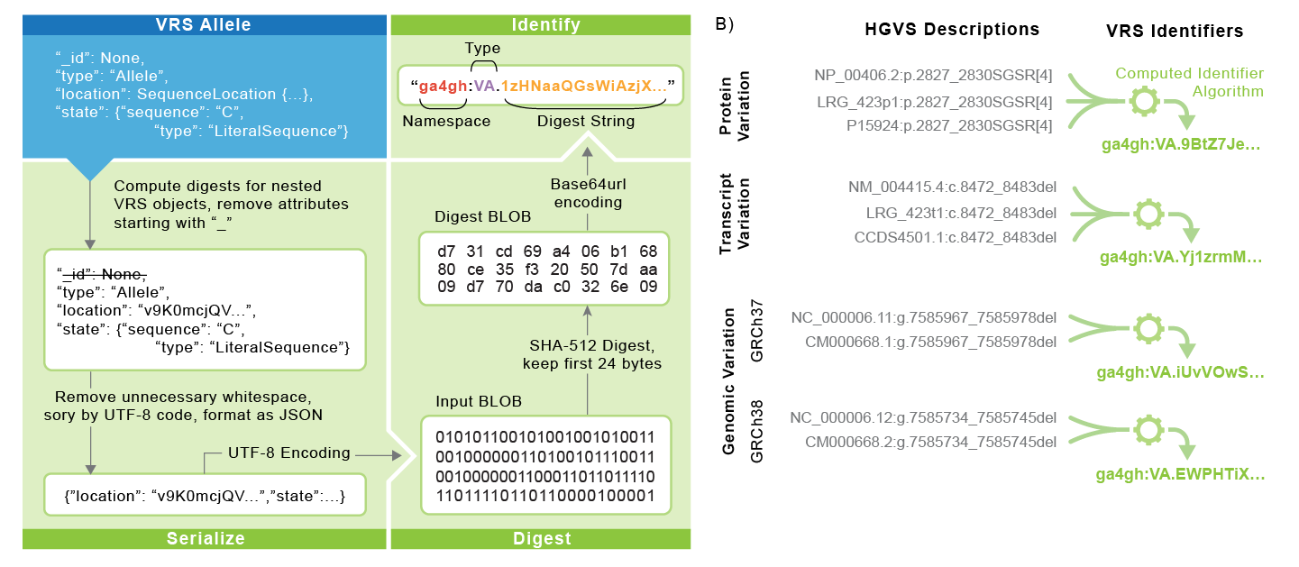
Converting Value Objects into Identifiers
Wagner AH, et al. Cell Genomics. 2021
Notes:
AW

Slide 67
Questions?

Slide 68
Variant Interpretation

Slide 69


Genomic Medicine
Tumor DNA
Clinical Genomic Variant Report
Patient Care

Slide 70
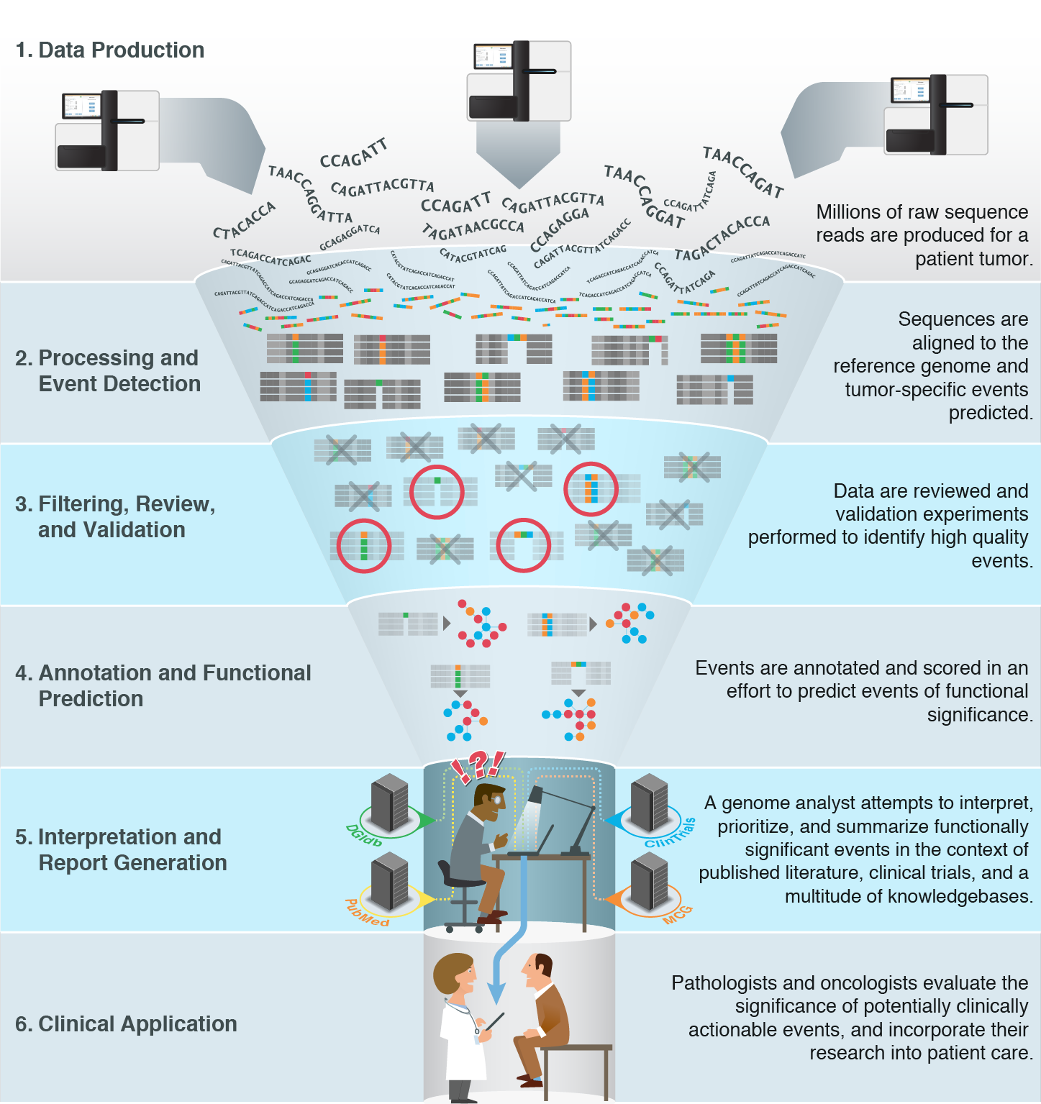
Variant Curation Case Load
7.3 hours per case for Brockman et al., Genetics in Medicine (2021)
6.4 hours per case for Medical Genome Initiative paper
Christina Austin-Tse, Broad Institute, unpublished data
6-8 hours per case at Institute for Genomic Medicine
Good BM, et al. Genome Biology (2014)

Slide 71
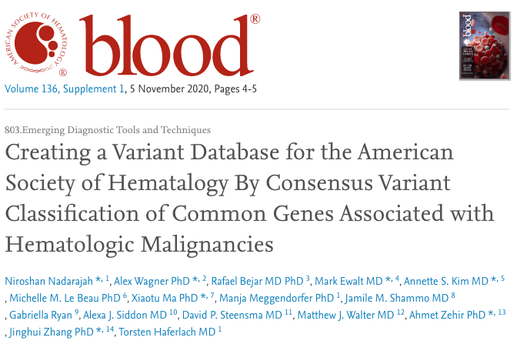
Interoperable knowledge is challenging

Slide 72
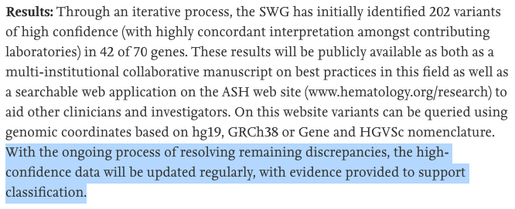
Interoperable knowledge is challenging

Slide 73


Variant is Oncogenic
Variant is Oncogenic
Variant is Oncogenic
Variant is Oncogenic
Variant is Oncogenic

Slide 74
Variant is Benign
Variant is Oncogenic
Variant is Likely Benign
Variant is ???
Variant is Oncogenic
Variant has uncertain significance
Variant is Benign

Slide 75
Variant is Benign
Variant is Oncogenic
Variant is Likely Benign
Variant is ???
~90% discordant (1778 / 1980 multi-submitter classifications)
Variant is Oncogenic
Variant has uncertain significance
Variant is Benign

Slide 76
Integrating knowledge is challenging
 | Variant Frequency |  |  |  | Pathogenicity Prediction |  |  |  |  | Variant Annotation
 | gnomAD | N-of-One | dbSNP | In-House Database | SIFT | Polyphen | Mutation Assessor | In-House Prediction Algorithms | Other Service(s), NOS | ClinVar | COSMIC | PCGP | HGMD | Annotation Database(s), NOS
Institution 1 | Y | Y |  |  | Y | Y | Y |  |  | Y | Y
Institution 2 |  |  |  |  | Y | Y |  |  | Y | Y | Y |  |  | Y
 | Y |  | Y | Y |  |  |  | Y |  | Y | Y
Institution 4 | Y |  |  |  | Y | Y |  |  | Y
Institution 5 | Y |  |  |  | Y | Y |  |  | Y |  |  |  |  | Y
Institution 6 |  |  |  |  |  |  |  |  | Y | Y | Y | Y | Y | Y
 | Externally Available Data and Tools
 | Internally Available Data and Tools
 | Mixed or unspecified

Slide 77
Variant Interpretation Frameworks

Slide 78
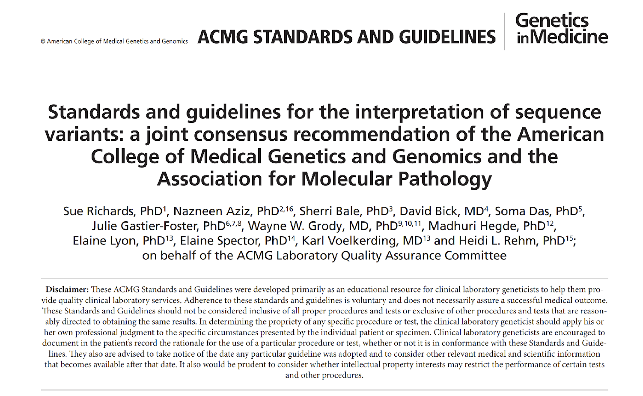

Slide 79
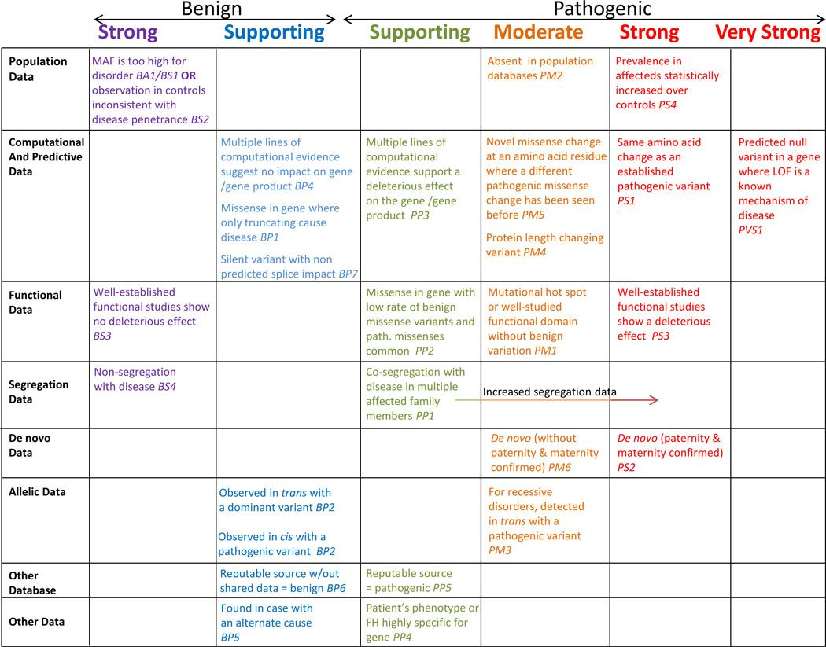
Genet Med. 2015 May;17(5):405-24.

Slide 80
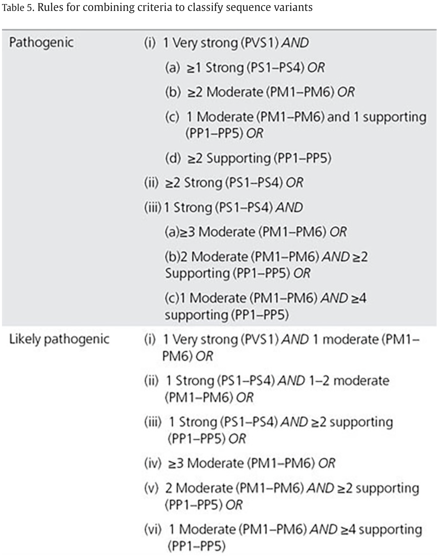
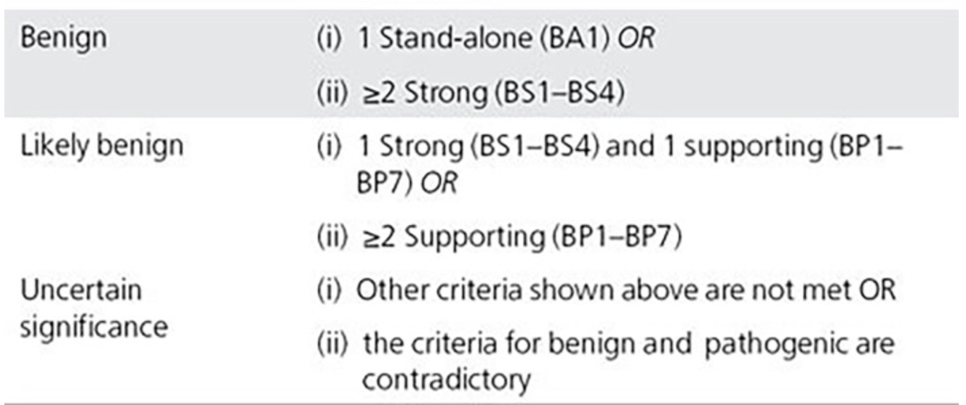

Slide 81
ClinVar Classifications

Slide 82
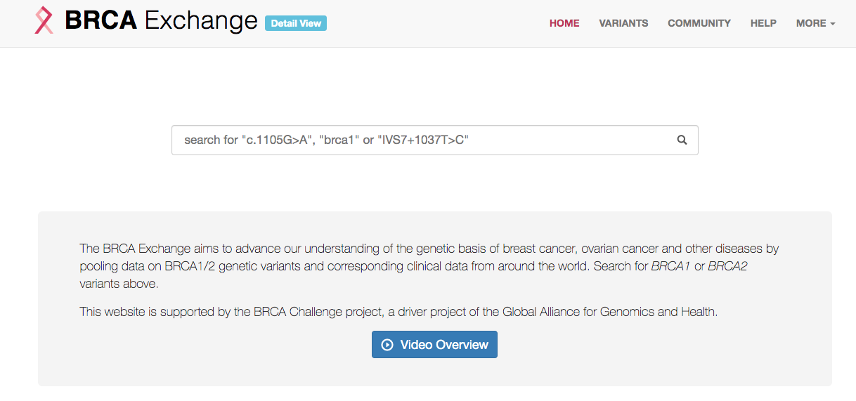
Gene Focus: BRCA1 and BRCA2
https://brcaexchange.org/

Slide 83
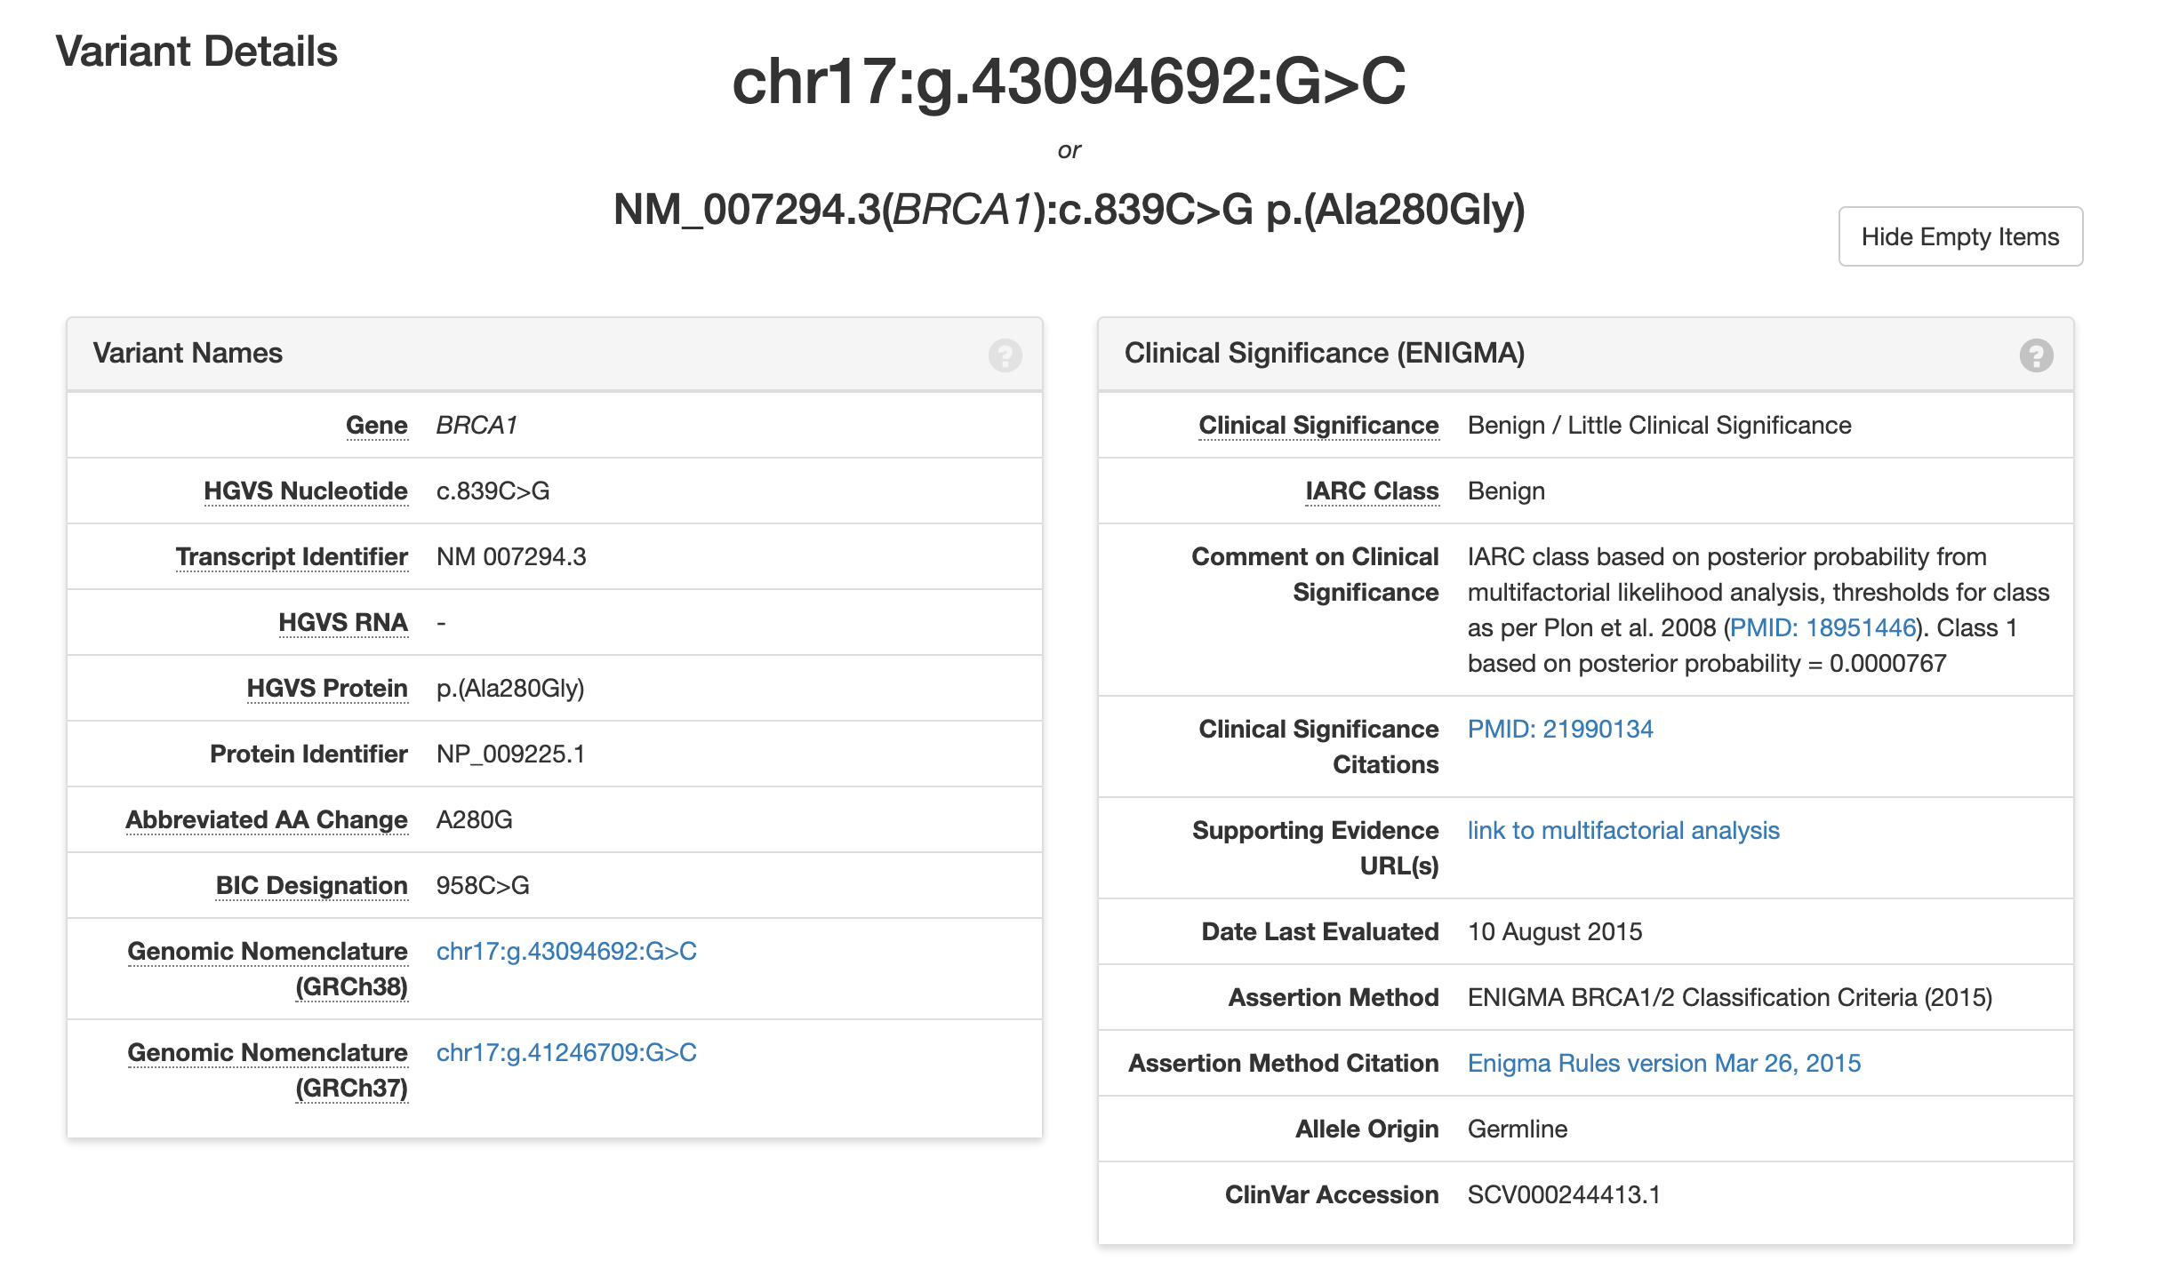
https://brcaexchange.org/variant/230931

Slide 84
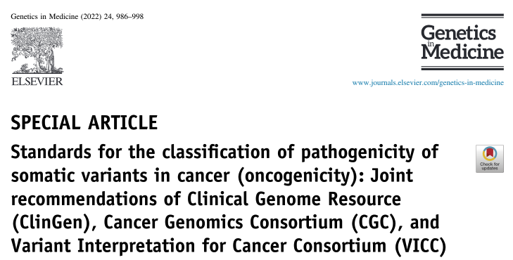



Cross-consortia Guidelines for Oncogenicity Assessment

Slide 85
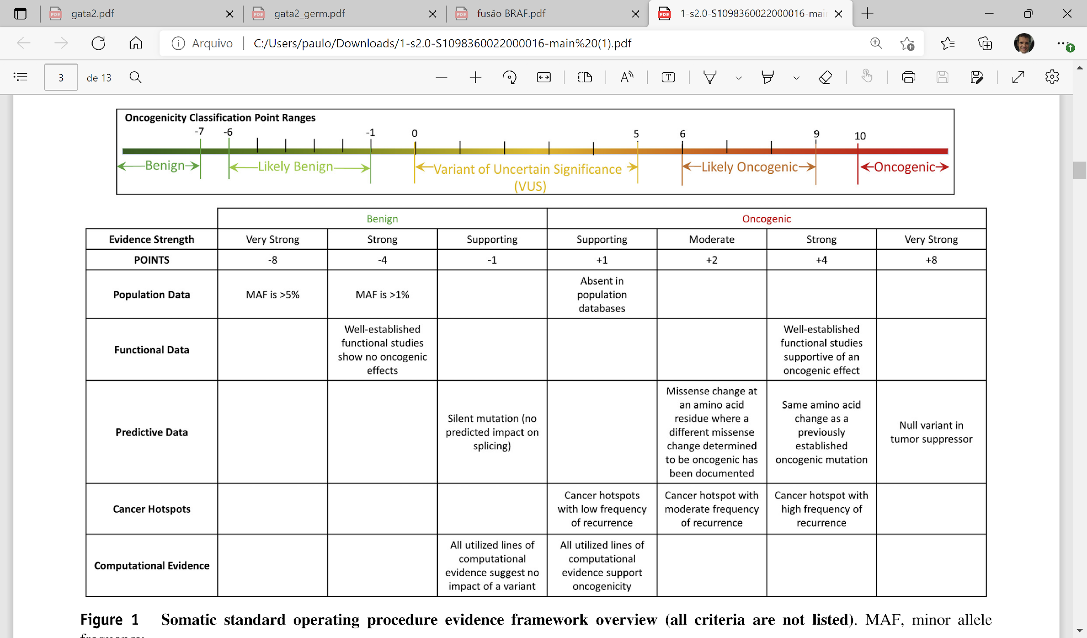
Horak P, et al. Genet Med. 2022

Slide 86
Horak P, et al. Genet Med. 2022

Slide 87
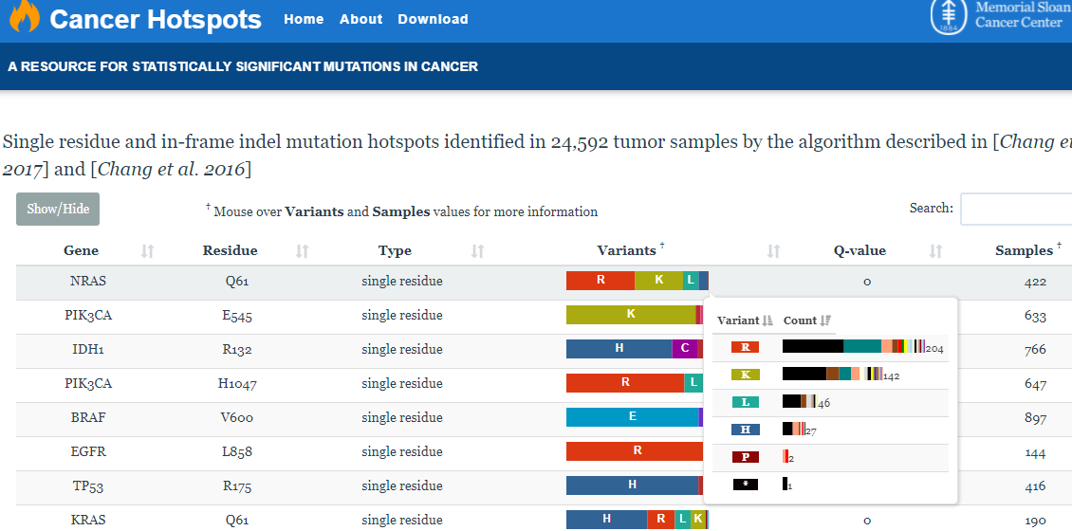

Slide 88
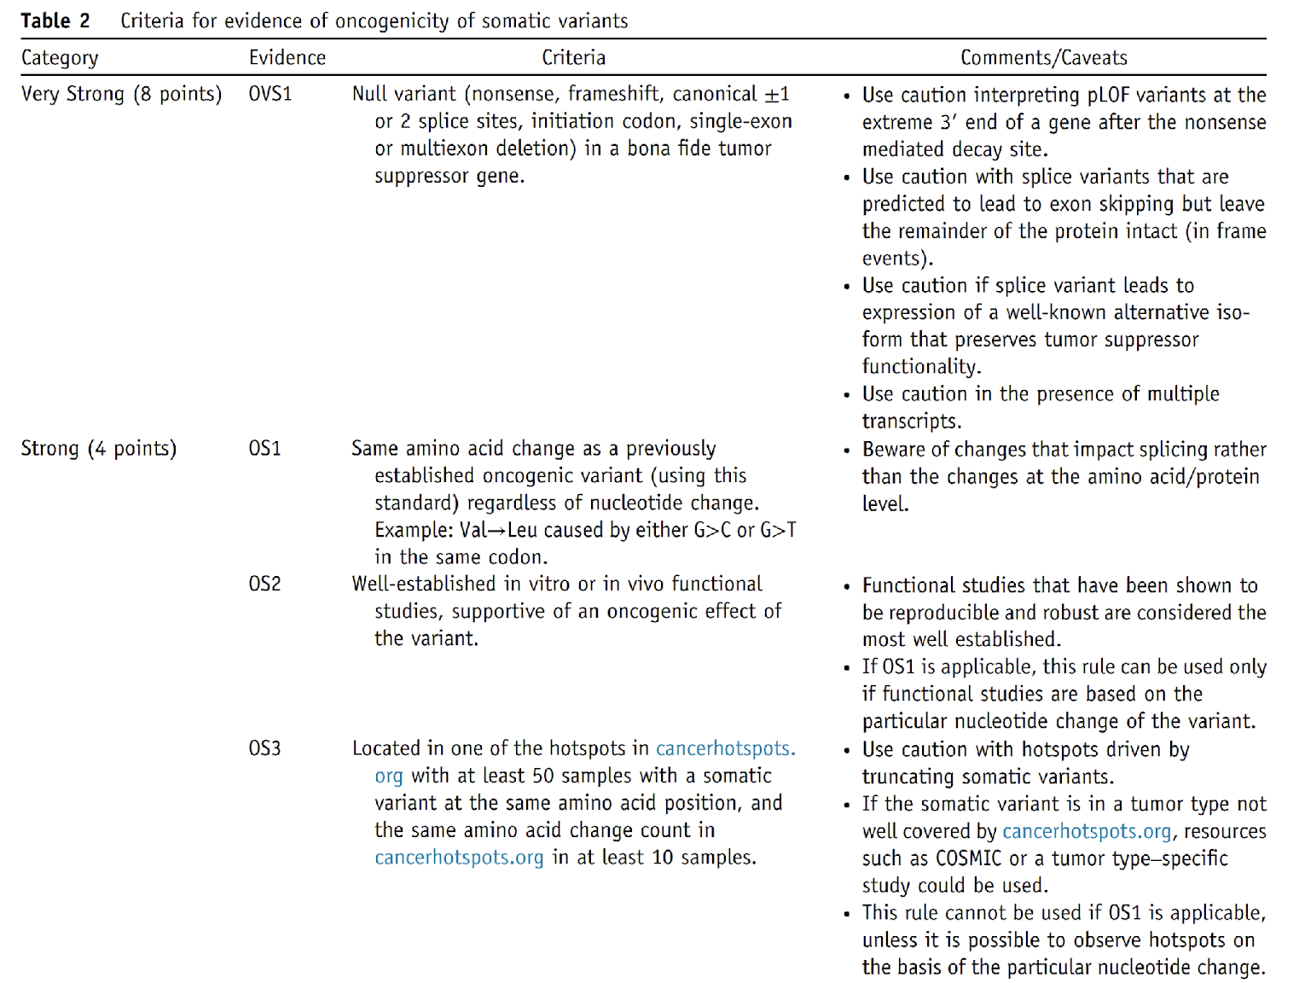

Slide 89
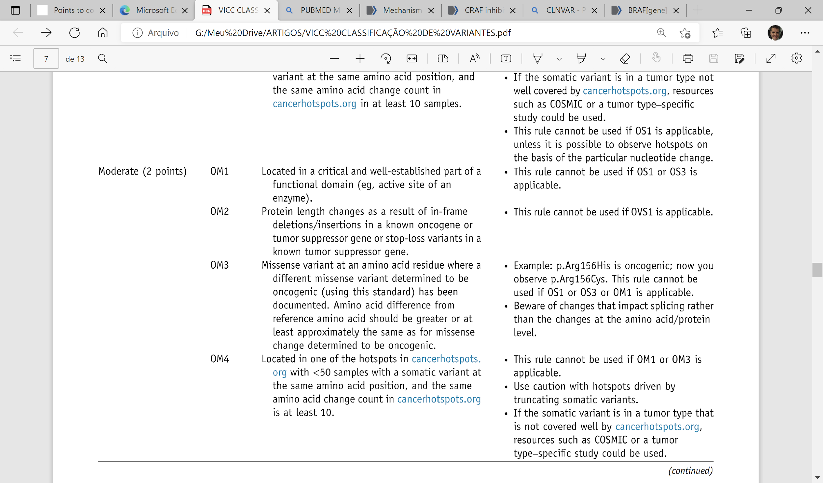
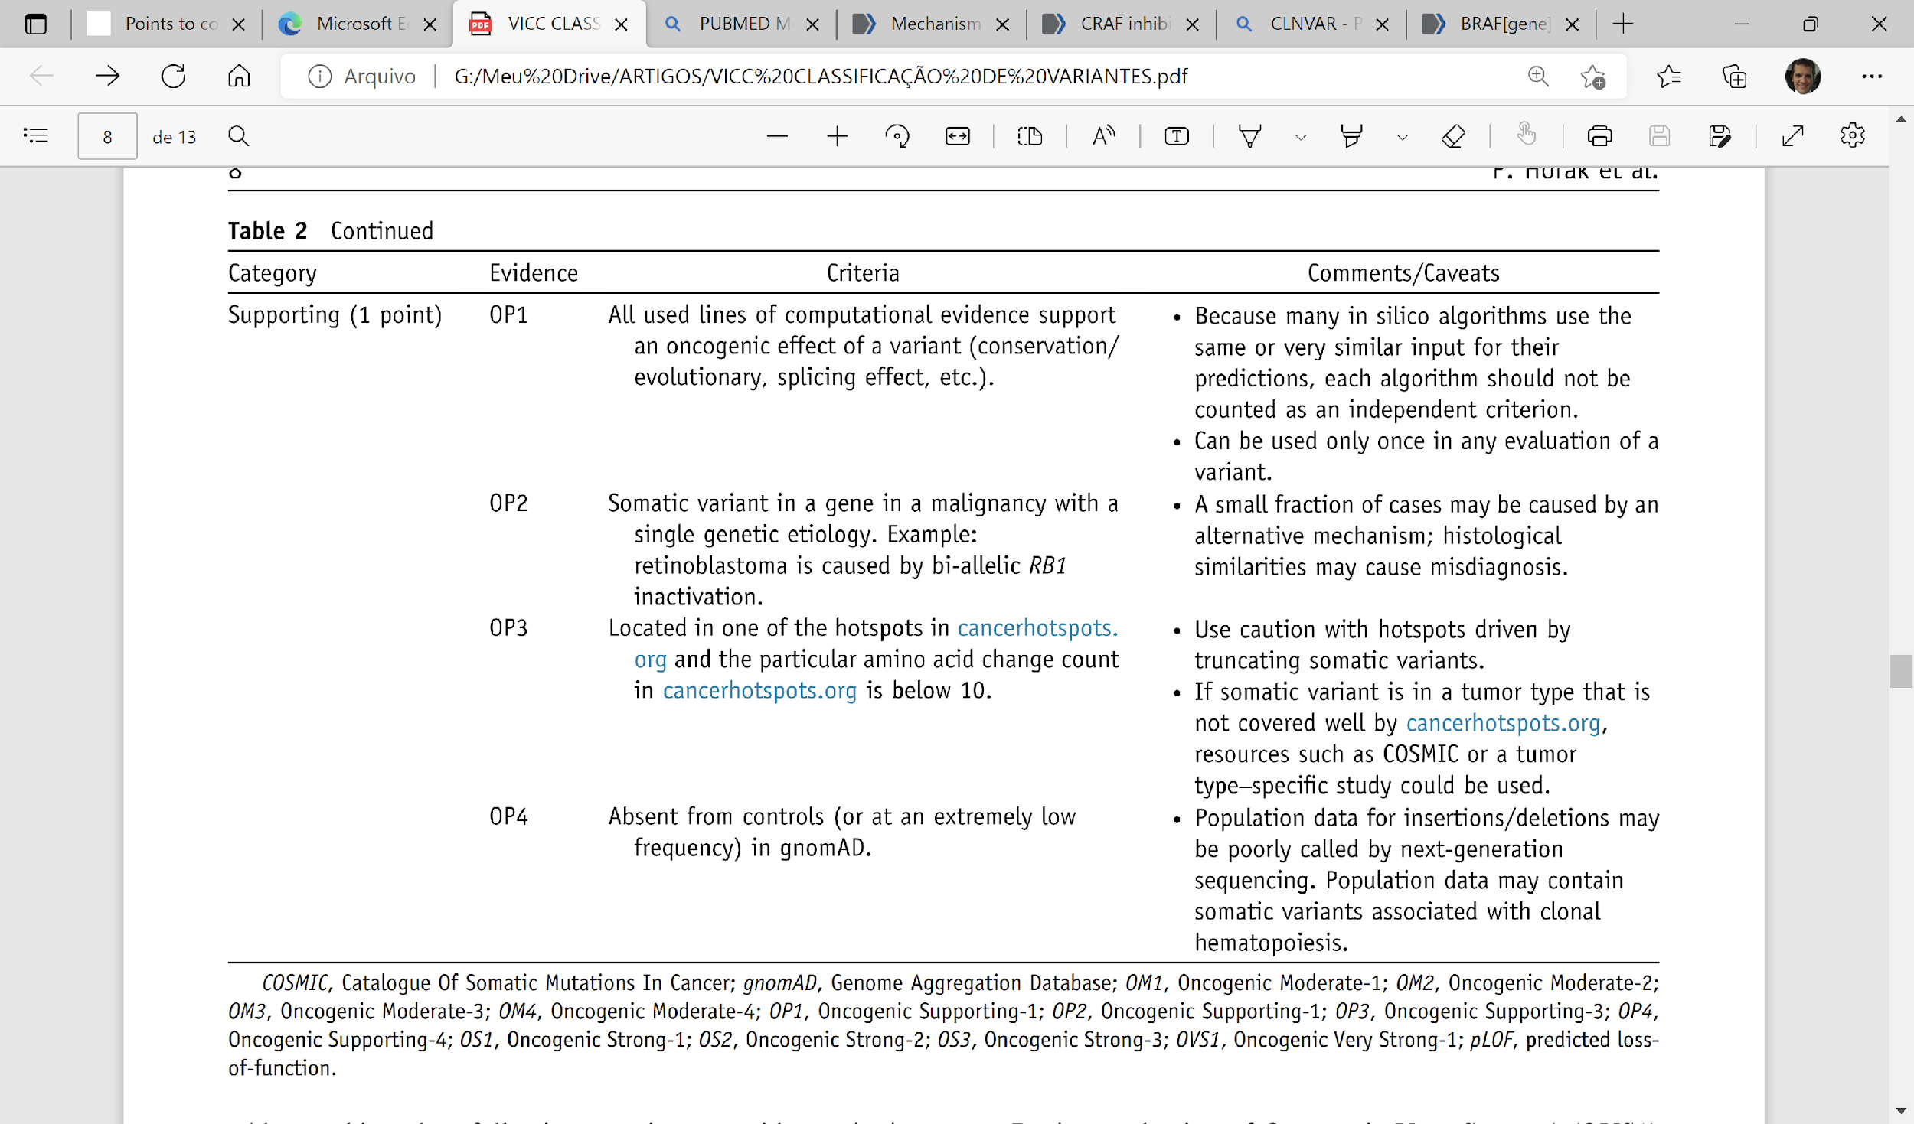

Slide 90
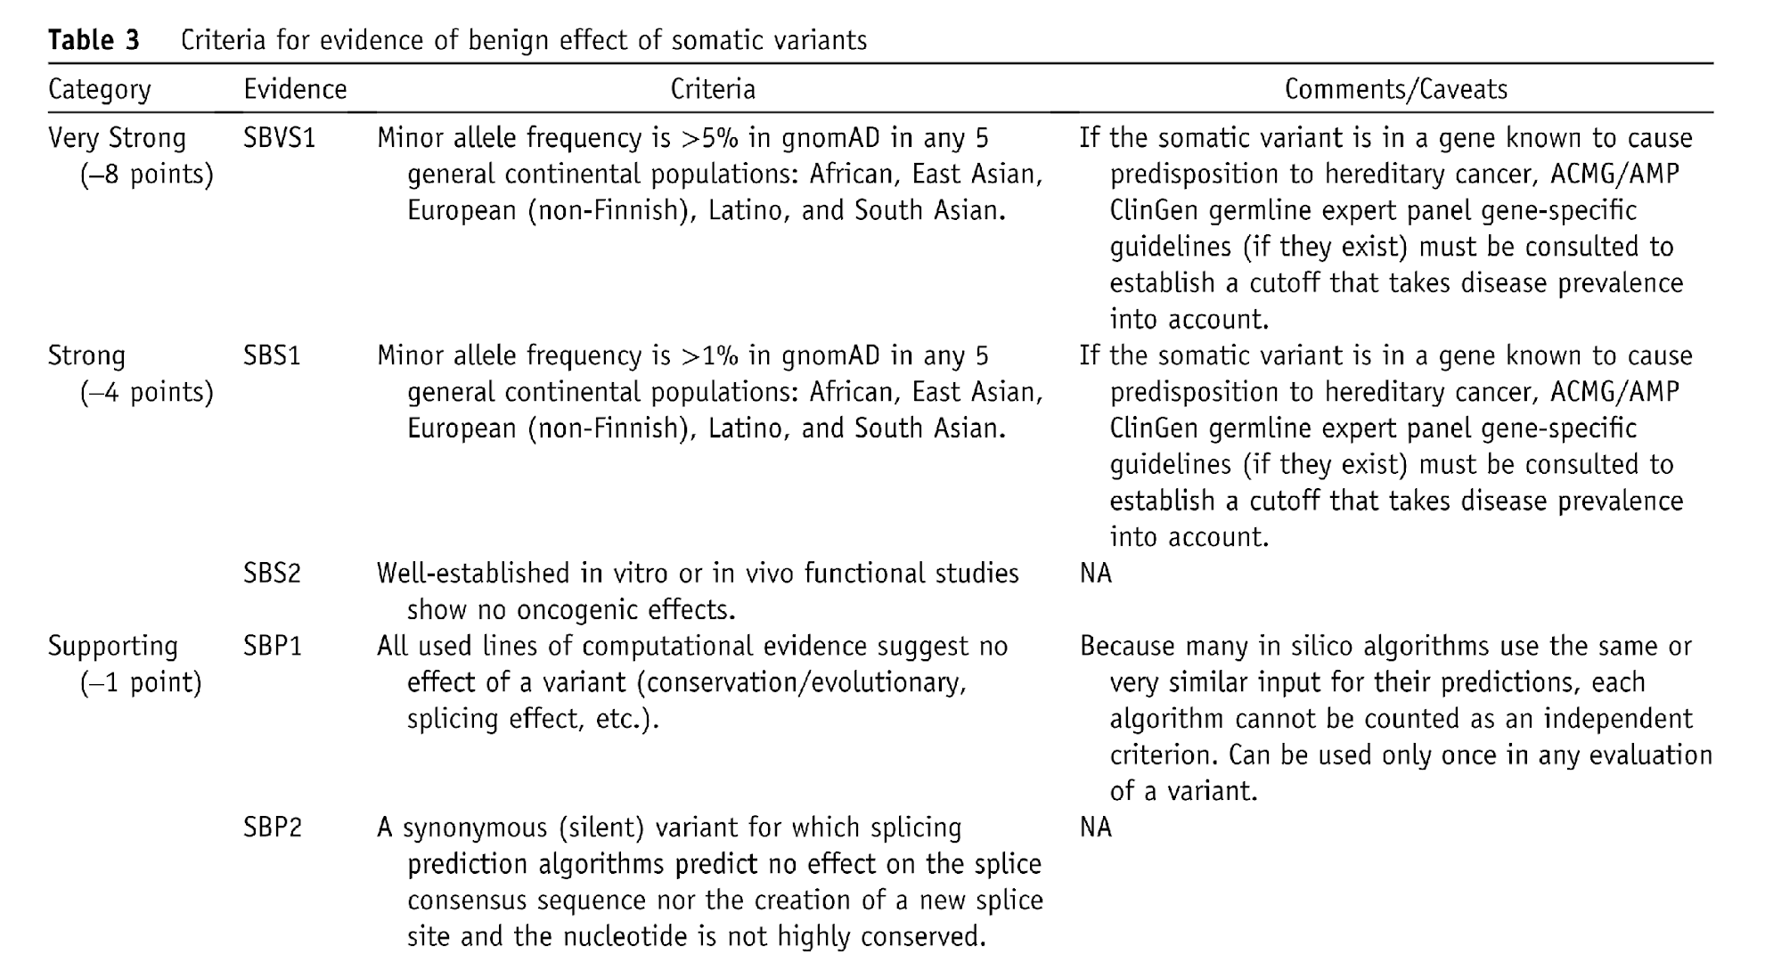

Slide 91
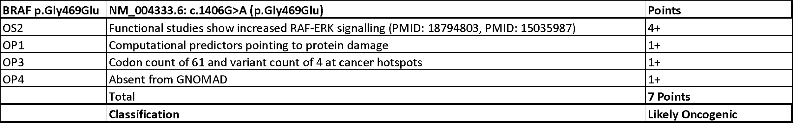
Examples

Slide 92
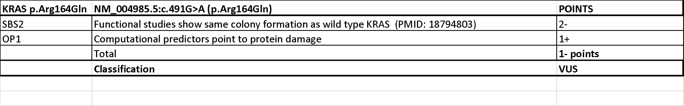
Examples

Slide 93
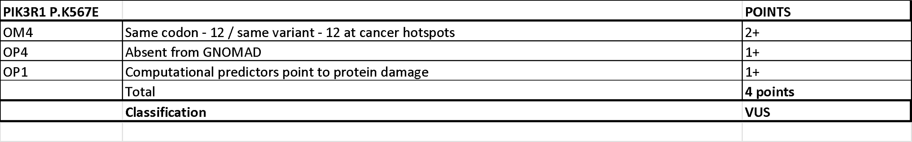
Examples

Slide 94
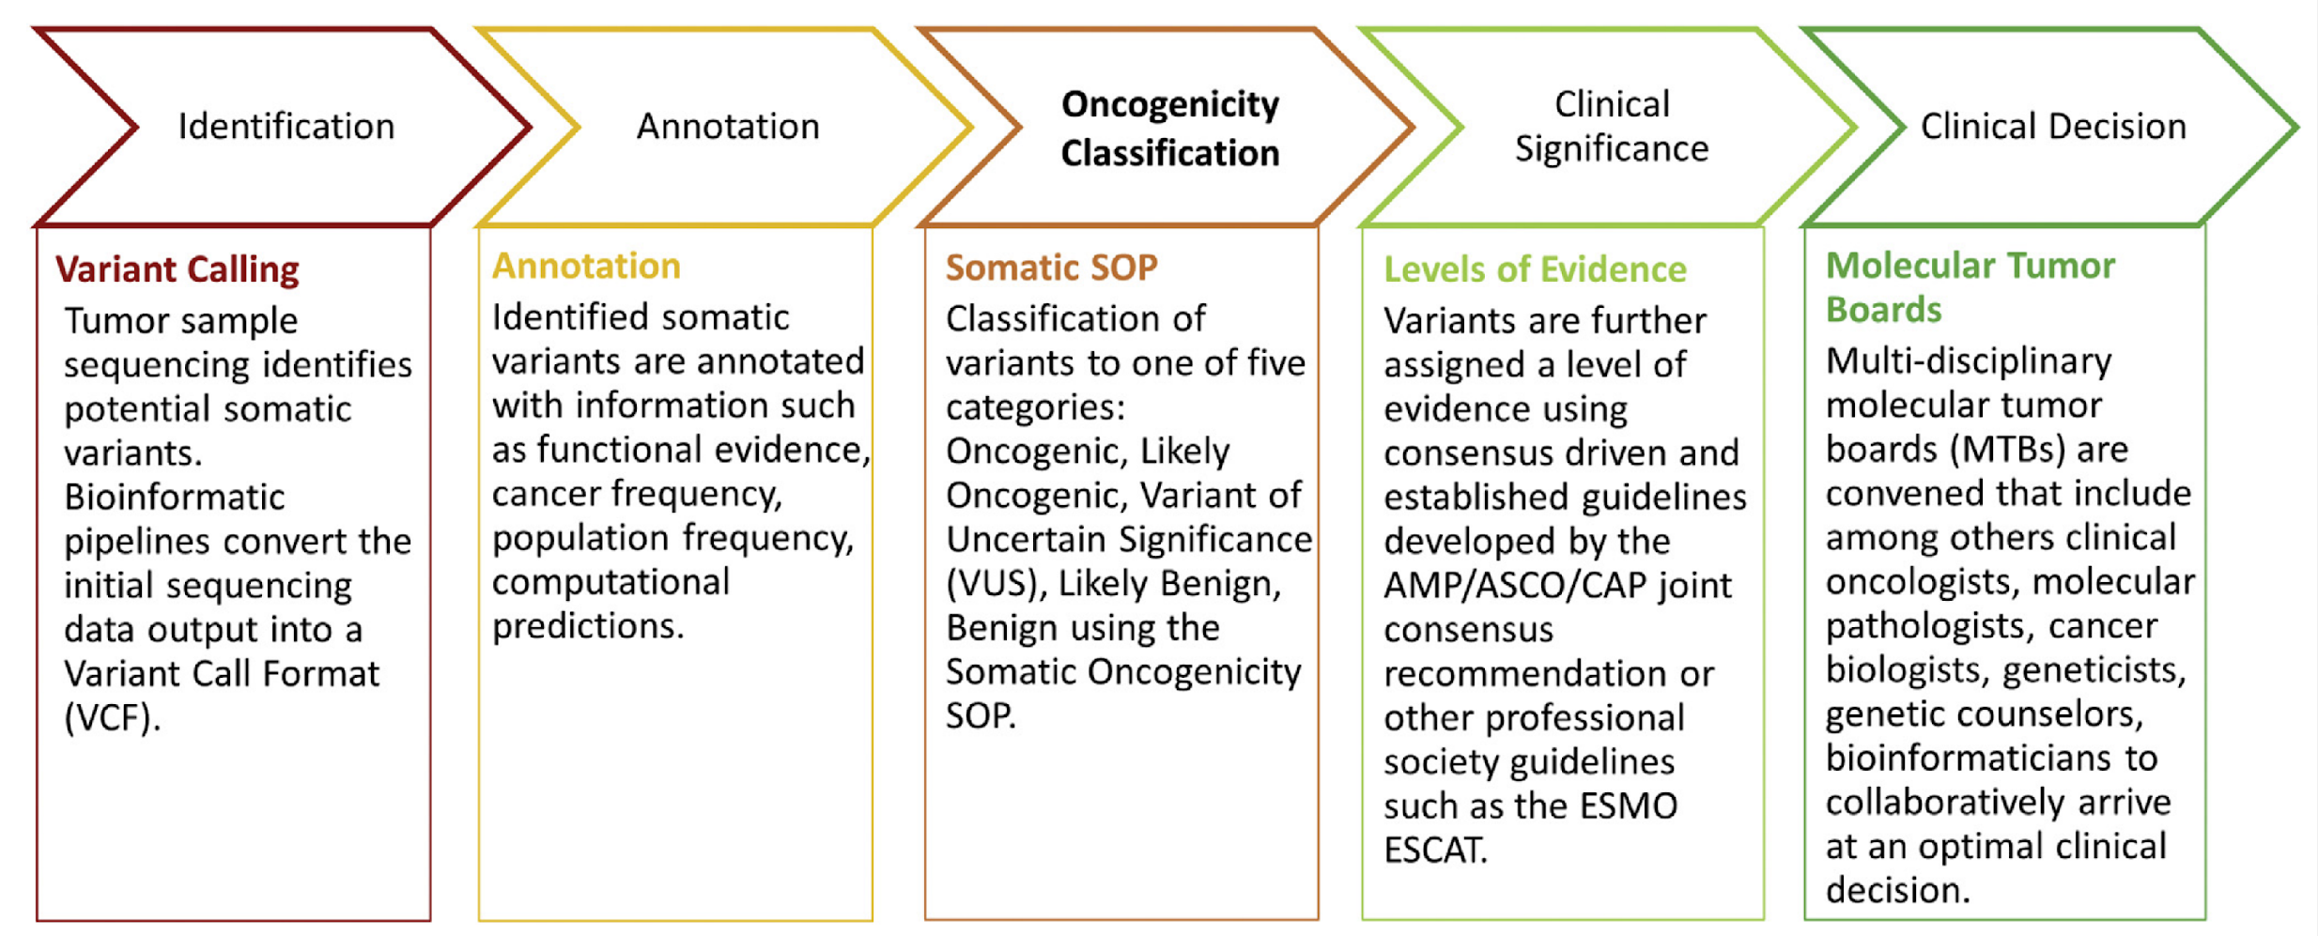
Classification and Interpretation of Variants in Cancer
Horak P, et al. Genet Med. 2022

Slide 95
Classification and Interpretation of Variants in Cancer
Horak P, et al. Genet Med. 2022

Slide 96
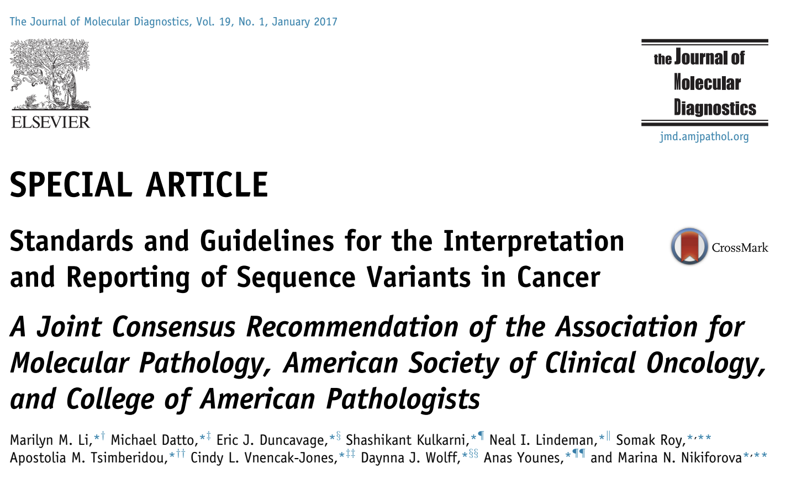

Slide 97
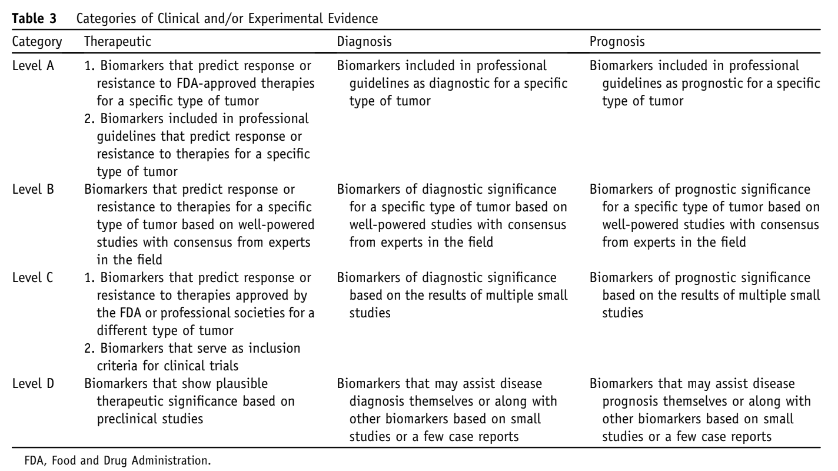

Slide 98


Slide 99

https://civicdb.org

Slide 100

https://docs.civicdb.org/en/latest/about/figures.html

Slide 101

civicdb.org/variants/12

Slide 102
Live Demonstration
civicdb.org/variants/12

Slide 103
General Questions

Slide 104

https://oncokb.org/

Slide 105

https://oncokb.org/gene/BRAF/V600E

Slide 106

https://oncokb.org/gene/BRAF/Oncogenic%20Mutations

Slide 107


Slide 108


Slide 109

https://ckb.jax.org/

Slide 110

https://ckb.jax.org/molecularProfile/showMolecularProfileByVariant?geneVariantId=49

Slide 111

https://ckb.jax.org/molecularProfile/showMolecularProfileByVariant?geneVariantId=49

Slide 112

https://ckb.jax.org/molecularProfile/showMolecularProfileByVariant?geneVariantId=49

Slide 113
Germline and Specialized Interpretation Resources

Slide 114

Disease Focus: Pediatric Cancers
https://pecan.stjude.cloud

Slide 115

Disease Focus: Pediatric Cancers
https://pecan.stjude.cloud/variant/74

Slide 116







Licensing
Cancer Biomarkers Database
More Permissive
Less Permissive
Attribution Only
Non-commercial / Research Only
Custom Licensing
Non-commercial
and Share-Alike
Paid-Access Only

